Slide 1
CS 65500 Advanced Cryptography
Lecture 0: Introduction
Instructor: Aarushi Goel
Spring 2025

Slide 2
Cryptography and its Evolution
Cryptography is the study of techniques for protecting sensitive/important information.
Old Cryptography
Modern Cryptography

Slide 3
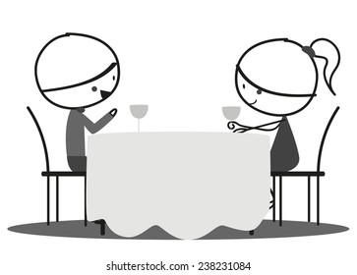
Alice and Bob go on a first date!
Alice
Bob
How can they determine if they both want a second date.
No one wants to ask first.
What if the other person is not interested?

Slide 4
What is the Average Salary of Purdue’s Class of 2024?
$$x_{5}$$
$$x_{1}$$
$$x_{4}$$
How can they compute the average without revealing their individual salaries to each other ?
$$x_{3}$$
$$x_{2}$$

Slide 5
Secure Multiparty Computation (MPC)
$$f$$
This general problem of enabling a group of mutually distrusting parties to jointly compute a function over their private data without the compromising confidentiality of that data is called secure multiparty computation.

Slide 6
Course Objectives
Understand the key security properties essential for secure multiparty computation.
Learn to formally define the problem of secure multiparty computation.
Explore various constructions of secure multiparty computation and develop the ability to rigorously prove their compliance with defined security requirements.

Slide 7
Logistics
Course Website: https://aarushigoel.github.io/courses/Spring%202025/CS655.html
Lectures: 3:00 pm – 4:15 pm, Tuesday and Thursday
Office hours: 11 am – 12 pm, Tuesday (LWSN 2142D)
Pre-requisites: CS 35500/55500 (or an equivalent course), basic probability, computational complexity and maturity with mathematical proofs.
Ed Discussion on Brightspace for all course relation discussions.

Slide 8
Grading Policy
10% Class Participation
20% Midterm
25% Final Exam
45% Homeworks (best 5 out of 6)

Slide 9
Homeworks
All homework must be submitted via Gradescope (on Brightspace).
Late Submission:
Upto 24 hours late -- a penalty of 50%.
More than 24 hours late -- no credit
Collaboration:
Write your own solution
Acknowledge everyone you’ve worked with
Cite all resources you’ve looked at

Slide 10
Exams
Midterm: In-Class (on March 6)
Final exam: Take-Home (Date TBD)
No collaboration, no extension!

Slide 11
Academic Dishonesty
Any instance of academic dishonesty will result in a significant penalty to your overall course grade and will be referred to the Office of the Dean of Students for further action.

Slide 12
Tentative-List of Topics
Defining Semi-Honest MPC
Oblivious Transfer
Semi-honest GMW
Yao’s Garbled Circuit
Simulation-Based Security
Zero-Knowledge Proofs, NIZKs
GMW Paradigm
Information-Theoretic MPC and Additive Attack Paradigm
MPC with Guaranteed Output Delivery
Packed Secret Sharing based MPC
Pseudorandom Correlation Generators
Homomorphic Secret Sharing
Fully Homomorphic Encryption
Private Set Intersection
Private Information Retrieval
Obfuscation, Secure enclaves

Slide 13
Toy Examples

Slide 14
Alice and Bob go on a first date!
Alice
Bob
They are now trying to determine if they both want a second date.
No one wants to ask first.
What if the other person is not interested?

Slide 15
The person who is not interested in a second date should not find out what the other person wanted.
Alice
Bob
$$a∈\left\{0,1\right\}$$
Logical AND
$$b∈\left\{0,1\right\}$$
Both Alice and Bob should only learn $a∧b$

Slide 16
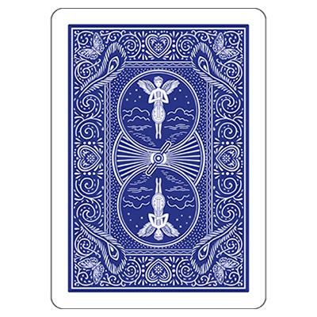
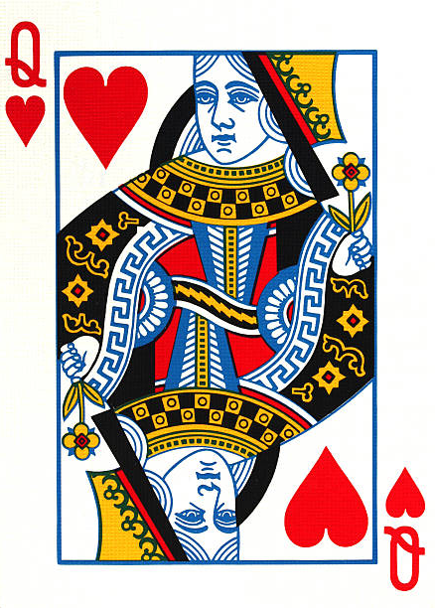
The Game of Like (Using Playing Cards) [dB89]
Alice
Bob

Slide 17
The Game of Like (Using Playing Cards)
If Bob likes Alice!
He puts the queen card on top
Alice
Bob

Slide 18
The Game of Like (Using Playing Cards)
If Bob likes Alice!
He puts the queen card on top
Alice
Bob

Slide 19
The Game of Like (Using Playing Cards)
If Bob likes Alice!
He puts the queen card on top
Alice
Bob

Slide 20
The Game of Like (Using Playing Cards)
If Bob likes Alice!
He puts the queen card on top
Alice
Bob

Slide 21
The Game of Like (Using Playing Cards)
If Bob likes Alice!
He puts the queen card on top
Alice
Bob

Slide 22
The Game of Like (Using Playing Cards)
If Bob likes Alice!
He puts the queen card on top
If Alice likes Bob!
Alice
She puts the king card on top
Bob

Slide 23
The Game of Like (Using Playing Cards)
If Bob likes Alice!
He puts the queen card on top
If Alice likes Bob!
Alice
She puts the king card on top
Bob

Slide 24
The Game of Like (Using Playing Cards)
If Bob likes Alice!
He puts the queen card on top
If Alice likes Bob!
Alice
She puts the king card on top
Bob

Slide 25
The Game of Like (Using Playing Cards)
If Bob likes Alice!
He puts the queen card on top
If Alice likes Bob!
Alice
She puts the king card on top
Bob

Slide 26
The Game of Like (Using Playing Cards)
If Bob likes Alice!
He puts the queen card on top
If Alice likes Bob!
Alice
She puts the king card on top
Bob

Slide 27
The Game of Like (Using Playing Cards)
If Bob likes Alice!
He puts the queen card on top
If Alice likes Bob!
Alice
She puts the king card on top
Bob
Alice and Bob now take turns to cut the deck

Slide 28
The Game of Like (Using Playing Cards)
If Bob likes Alice!
He puts the queen card on top
If Alice likes Bob!
Alice
She puts the king card on top
Bob
Alice and Bob now take turns to cut the deck

Slide 29
The Game of Like (Using Playing Cards)
If Bob likes Alice!
He puts the queen card on top
If Alice likes Bob!
Alice
She puts the king card on top
Bob
Alice and Bob now take turns to cut the deck

Slide 30
The Game of Like (Using Playing Cards)
Alice likes Bob, but Bob does not like Alice
Alice
Bob

Slide 31
The Game of Like (Using Playing Cards)
Alice likes Bob, but Bob does not like Alice
Alice
Bob

Slide 32
The Game of Like (Using Playing Cards)
Alice and Bob like each other
Alice
Bob

Slide 33
The Game of Like (Using Playing Cards)
Alice and Bob like each other
Alice
Bob

Slide 34
The Game of Like (Using Playing Cards)
Alice and Bob like each other
Alice
Bob
Queens are together!

Slide 35
The Game of Like (Using Playing Cards)
Alice and Bob open the cards are place them in a circle
Alice
Bob
If queens are together, they both like each other

Slide 36
The Game of Like (Using Playing Cards)
Alice and Bob open the cards are place them in a circle
Alice
Bob
Else, at least one of them doesn’t want to go on a second date.

Slide 37
What is the Average Salary of Purdue’s Class of 2024?
$$x_{5}$$
$$x_{1}$$
$$x_{4}$$
$$x_{3}$$
$$x_{2}$$

Slide 38
Secure Computation of Average Salary
$$m_{5}=m_{4}+x_{5}$$
$$m_{4}=m_{3}+x_{4}$$
$$out=\frac{m_{5}−r}{5}$$
$$m_{1}=x_{1}+r$$
$$m_{2}=m_{1}+x_{1}$$
$$m_{3}=m_{2}+x_{3}$$

Slide 39
What could go wrong with this approach?
What if these two parties collude?
$$m_{5}=m_{4}+x_{5}$$
$$m_{4}=m_{3}+x_{4}$$
$$out=\frac{m_{5}−r}{5}$$
$$m_{1}=x_{1}+r$$
$$m_{2}=m_{1}+x_{1}$$
$$m_{3}=m_{2}+x_{3}$$

Slide 40
What could go wrong with this approach?
$$m_{5}=m_{4}+x_{5}$$
$$m_{4}=m_{3}+x_{4}$$
$$out=\frac{m_{5}−r}{5}$$
$$m_{1}=x_{1}+r$$
$$m_{2}=m_{1}+x_{1}$$
$$m_{3}=m_{2}+x_{3}$$
What if he sets $m_{3}=0$?

Slide 41
What could go wrong with this approach?
$$m_{5}=m_{4}+x_{5}$$
$$m_{4}=m_{3}+x_{4}$$
$$out=\frac{m_{5}−r}{5}$$
$$m_{1}=x_{1}+r$$
$$m_{2}=m_{1}+x_{1}$$
$$m_{3}=m_{2}+x_{3}$$
This protocol is only secure in the setting where the parties neither collude with each other, nor do they deviate from the protocol description.

