Slide 1
Multiparty Distributed Point Functions
Aarushi Goel Mingyuan Wang Zhiheng Wang
Theory and Practice of Laconic Cryptography | EUROCRYPT 2025

Slide 2
Function Secret Sharing [GI14]
$$Eval (f_{1},x)$$
$$f_{1}$$
$$y_{1}$$
Correctness:
$y_{1}+y_{2}+…+y_{n}=f(x)$
$$Eval (f_{2},x)$$
$$y_{2}$$
$$f$$
$$f_{2}$$
.
.
.
.
.
.
.
.
.
Privacy:
Any $(n−1)$ subset of shares hide $f$
Efficiency:
$${|f}_{1}|+…+|f_{n}|= o(|f|)$$
$$Eval (f_{n},x)$$
$$y_{n}$$
$$f_{n}$$
share
evaluation

Slide 3
Point Functions
$$if x=α$$
$$β,$$
$${ f}_{α,β}(x) =$$
0 | … | … | … | $$β$$ | … | … | 0 | … | 0
$$otherwise$$
$$0,$$
$1$ ... $α$ … $|D|$
${ f}_{α,β} :D→R$
Distributed Point Functions [GI14,BGI15]
Function secret sharing for point functions

Slide 4
Distributed Point Functions: Applications

Slide 5
Distributed Point Functions: Constructions
(Based on Minicrypt Assumptions)
2-party DPFs
[GI14]
[BGI15]
[BGI19]
[BGIK22]
[BDSS25, BGHIT25]
Share size $=O(polylog(|D|))$
$n$-party DPFs
[BGI15]
Share size $=O(2^{n−1}.\sqrt{|D|})$

Slide 6
Main Question?
Do efficient multiparty DPFs exist for any number of parties?
(using minicrypt assumptions)
From one-way functions
Share size = $O(n^{4}.\sqrt{|D|})$

Slide 7
Techniques

Slide 8
2-Party DPF [BGI15]
Total share sizes = $O(\sqrt{|D|})$
0 | 0 | 0 | 0 | 0 | $$β$$ | 0 | 0 | 0 | 0 | 0 | 0 | 0 | 0 | 0 | 0

Slide 9
2-Party DPF [BGI15]
Total share sizes = $O(\sqrt{|D|})$
0 | 0 | 0 | 0
0 | $$β$$ | 0 | 0
0 | 0 | 0 | 0
0 | 0 | 0 | 0

Slide 10
2-Party DPF [BGI15]
Total share sizes = $O(\sqrt{|D|})$
0 | 0 | 0 | 0
$$s_{1}\underset{←}{\$}{\{0,1\}}^{λ}$$
0 | $$β$$ | 0 | 0
$s_{2}\underset{←}{\$}{\{0,1\}}^{λ}$,
$${ s}_{2}^{∗}\underset{←}{\$}{\{0,1\}}^{λ}$$
0 | 0 | 0 | 0
$$s_{3}\underset{←}{\$}{\{0,1\}}^{λ}$$
0 | 0 | 0 | 0
$$s_{4}\underset{←}{\$}{\{0,1\}}^{λ}$$

Slide 11
2-Party DPF [BGI15]
Total share sizes = $O(\sqrt{|D|})$
0 | 0 | 0 | 0
$$s_{1}\underset{←}{\$}{\{0,1\}}^{λ}$$
0 | $$β$$ | 0 | 0
$s_{2}\underset{←}{\$}{\{0,1\}}^{λ}$,
$${ s}_{2}^{∗}\underset{←}{\$}{\{0,1\}}^{λ}$$
0 | 0 | 0 | 0
$$s_{3}\underset{←}{\$}{\{0,1\}}^{λ}$$
0 | 0 | 0 | 0
$$s_{4}\underset{←}{\$}{\{0,1\}}^{λ}$$
Let $PRG:{\{0,1\}}^{λ}→{\{0,1\}}^{4}$
DPF Shares (Attempt 1)
DPF Evaluation (Attempt 1)
Let $Eval=PRG$
$∀i≠2: PRG\left(s_{i}\right)⊕PRG\left(s_{i}\right)=0^{4}$
$$s_{1}$$
$$s_{1}$$
$$i=2: PRG\left(s_{2}\right)⊕PRG\left({ s}_{2}^{∗}\right)=r$$
$$s_{2}$$
$${ s}_{2}^{∗}$$
Pseudorandom string
$$s_{3}$$
$$s_{3}$$
$$s_{4}$$
$$s_{4}$$
We want $Eval\left(s_{2}\right)⊕Eval\left({ s}_{2}^{∗}\right)=0β00$

Slide 12
2-Party DPF [BGI15]
Total share sizes = $O(\sqrt{|D|})$
0 | 0 | 0 | 0
$$s_{1}\underset{←}{\$}{\{0,1\}}^{λ}$$
Correction word
$w=$ $PRG\left(s_{2}\right)⊕PRG\left({ s}_{2}^{∗}\right)$ $⊕$ $0β00$
0 | $$β$$ | 0 | 0
$s_{2}\underset{←}{\$}{\{0,1\}}^{λ}$,
$${ s}_{2}^{∗}\underset{←}{\$}{\{0,1\}}^{λ}$$
0 | 0 | 0 | 0
$$s_{3}\underset{←}{\$}{\{0,1\}}^{λ}$$
0 | 0 | 0 | 0
$$s_{4}\underset{←}{\$}{\{0,1\}}^{λ}$$
Let $PRG:{\{0,1\}}^{λ}→{\{0,1\}}^{4}$
DPF Shares
DPF Evaluation
$$s_{1}$$
$$s_{1}$$
$$s_{2}$$
$${ s}_{2}^{∗}$$
$$s_{3}$$
$$s_{3}$$
$$s_{4}$$
$$s_{4}$$
We want $Eval\left(s_{2}\right)⊕Eval\left({ s}_{2}^{∗}\right)=0β00$
$$w$$
$$w$$

Slide 13
2-Party DPF [BGI15]
Total share sizes = $O(\sqrt{|D|})$
0 | 0 | 0 | 0
$$s_{1}\underset{←}{\$}{\{0,1\}}^{λ}$$
$${ b}_{1}\underset{←}{\$}\{0,1\}$$
Correction word
$w=$ $PRG\left(s_{2}\right)⊕PRG\left({ s}_{2}^{∗}\right)$ $⊕$ $0β00$
0 | $$β$$ | 0 | 0
$s_{2}\underset{←}{\$}{\{0,1\}}^{λ}$, ${ s}_{2}^{∗}\underset{←}{\$}{\{0,1\}}^{λ}$
$${ b}_{2}\underset{←}{\$}\{0,1\}$$
0 | 0 | 0 | 0
$$s_{3}\underset{←}{\$}{\{0,1\}}^{λ}$$
$${ b}_{3}\underset{←}{\$}\{0,1\}$$
0 | 0 | 0 | 0
$$s_{4}\underset{←}{\$}{\{0,1\}}^{λ}$$
$${ b}_{4}\underset{←}{\$}\{0,1\}$$
Let $PRG:{\{0,1\}}^{λ}→{\{0,1\}}^{4}$
DPF Shares
DPF Evaluation
$$s_{1}$$
$$s_{1}$$
$$s_{2}$$
$${ s}_{2}^{∗}$$
$$s_{3}$$
$$s_{3}$$
$$s_{4}$$
$$s_{4}$$
We want $Eval\left(s_{2}\right)⊕Eval\left({ s}_{2}^{∗}\right)=0β00$
$$w$$
$$w$$

Slide 14
2-Party DPF [BGI15]
Total share sizes = $O(\sqrt{|D|})$
0 | 0 | 0 | 0
$$s_{1}\underset{←}{\$}{\{0,1\}}^{λ}$$
$${ b}_{1}\underset{←}{\$}\{0,1\}$$
Correction word
$w=$ $PRG\left(s_{2}\right)⊕PRG\left({ s}_{2}^{∗}\right)$ $⊕$ $0β00$
0 | $$β$$ | 0 | 0
$s_{2}\underset{←}{\$}{\{0,1\}}^{λ}$, ${ s}_{2}^{∗}\underset{←}{\$}{\{0,1\}}^{λ}$
$${ b}_{2}\underset{←}{\$}\{0,1\}$$
0 | 0 | 0 | 0
$$s_{3}\underset{←}{\$}{\{0,1\}}^{λ}$$
$${ b}_{3}\underset{←}{\$}\{0,1\}$$
0 | 0 | 0 | 0
$$s_{4}\underset{←}{\$}{\{0,1\}}^{λ}$$
$${ b}_{4}\underset{←}{\$}\{0,1\}$$
Let $PRG:{\{0,1\}}^{λ}→{\{0,1\}}^{4}$
DPF Shares
DPF Evaluation
$$s_{1}$$
$$s_{1}$$
,${ b}_{1}$
,${ b}_{1}$
$$s_{2}$$
$${ s}_{2}^{∗}$$
,${ b}_{2}$
,${ 1−b}_{2}$
$$s_{3}$$
$$s_{3}$$
,${ b}_{3}$
,${ b}_{3}$
$$s_{4}$$
,${ b}_{4}$
$$s_{4}$$
,${ b}_{4}$
We want $Eval\left(s_{2}\right)⊕Eval\left({ s}_{2}^{∗}\right)=0β00$
$$w$$
$$w$$

Slide 15
2-Party DPF [BGI15]
Total share sizes = $O(\sqrt{|D|})$
0 | 0 | 0 | 0
$$s_{1}\underset{←}{\$}{\{0,1\}}^{λ}$$
$${ b}_{1}\underset{←}{\$}\{0,1\}$$
Correction word
$w=$ $PRG\left(s_{2}\right)⊕PRG\left({ s}_{2}^{∗}\right)$ $⊕$ $0β00$
0 | $$β$$ | 0 | 0
$s_{2}\underset{←}{\$}{\{0,1\}}^{λ}$, ${ s}_{2}^{∗}\underset{←}{\$}{\{0,1\}}^{λ}$
$${ b}_{2}\underset{←}{\$}\{0,1\}$$
0 | 0 | 0 | 0
$$s_{3}\underset{←}{\$}{\{0,1\}}^{λ}$$
$${ b}_{3}\underset{←}{\$}\{0,1\}$$
0 | 0 | 0 | 0
$$s_{4}\underset{←}{\$}{\{0,1\}}^{λ}$$
$${ b}_{4}\underset{←}{\$}\{0,1\}$$
Let $PRG:{\{0,1\}}^{λ}→{\{0,1\}}^{4}$
DPF Shares
DPF Evaluation
$Eval(P_{A},s_{i}^{A},b_{i}^{A},w)=PRG(s_{i}^{A})⊕b_{i}^{A}$. $w$
$$s_{1}$$
$$s_{1}$$
$Eval(P_{B},s_{i}^{B},b_{i}^{B},w)=PRG(s_{i}^{B})⊕b_{i}^{B}$. $w$
,${ b}_{1}$
,${ b}_{1}$
$$s_{2}$$
$${ s}_{2}^{∗}$$
,${ b}_{2}$
,${ 1−b}_{2}$
$$s_{3}$$
$$s_{3}$$
,${ b}_{3}$
$i≠2: Eval(P_{A},s_{i}^{A},b_{i}^{A},w)⊕Eval(P_{B},s_{i}^{B},b_{i}^{B},w)=0^{4}$
,${ b}_{3}$
$$s_{4}$$
,${ b}_{4}$
$$s_{4}$$
,${ b}_{4}$
$$i=2:Eval(P_{A},s_{i}^{A},b_{i}^{A},w)⊕Eval(P_{B},s_{i}^{B},b_{i}^{B},w)=0β00$$
$$w$$
$$w$$

Slide 16
2-Party DPF [BGI15]
Distribution of seeds
Seeds associated with non-special rows
Seeds associated with special row
$$s$$
$$s$$
0 | 0 | 0 | 0
$$s_{1}\underset{←}{\$}{\{0,1\}}^{λ}$$
0 | $$β$$ | 0 | 0
$s_{2}\underset{←}{\$}{\{0,1\}}^{λ}$, ${ s}_{2}^{∗}\underset{←}{\$}{\{0,1\}}^{λ}$
0 | 0 | 0 | 0
$$s_{3}\underset{←}{\$}{\{0,1\}}^{λ}$$
$$s^{∗}$$
$$s^{∗}$$
0 | 0 | 0 | 0
$$s_{4}\underset{←}{\$}{\{0,1\}}^{λ}$$

Slide 17
$n$-Party DPF [BGI15]
Distribution of seeds
0 | 0 | 0 | 0
$$s_{1}^{1}\underset{←}{\$}{\{0,1\}}^{λ},…,s_{ℓ}^{1}\underset{←}{\$}{\{0,1\}}^{λ}$$
0 | $$β$$ | 0 | 0
$$s_{1}^{2}\underset{←}{\$}{\{0,1\}}^{λ},…,s_{ℓ}^{2}\underset{←}{\$}{\{0,1\}}^{λ}$$
0 | 0 | 0 | 0
$$s_{1}^{3}\underset{←}{\$}{\{0,1\}}^{λ},…,s_{ℓ}^{3}\underset{←}{\$}{\{0,1\}}^{λ}$$
0 | 0 | 0 | 0
$$s_{1}^{4}\underset{←}{\$}{\{0,1\}}^{λ},…,s_{ℓ}^{4}\underset{←}{\$}{\{0,1\}}^{λ}$$
A subset of the seeds associated with each row are given to each party

Slide 18
$n$-Party DPF [BGI15]
Distribution of seeds
Seeds associated with non-special rows are given to even number of parties
Seeds associated with special row are given to odd number of parties
$$s_{1}^{i}$$
$$s_{1}^{2}$$
0 | 0 | 0 | 0
$$s_{1}^{1}\underset{←}{\$}{\{0,1\}}^{λ},…,s_{ℓ}^{1}\underset{←}{\$}{\{0,1\}}^{λ}$$
0 | $$β$$ | 0 | 0
$$s_{1}^{2}\underset{←}{\$}{\{0,1\}}^{λ},…,s_{ℓ}^{2}\underset{←}{\$}{\{0,1\}}^{λ}$$
$$s_{2}^{i}$$
$$s_{2}^{2}$$
0 | 0 | 0 | 0
$$s_{1}^{3}\underset{←}{\$}{\{0,1\}}^{λ},…,s_{ℓ}^{3}\underset{←}{\$}{\{0,1\}}^{λ}$$
0 | 0 | 0 | 0
$$s_{1}^{4}\underset{←}{\$}{\{0,1\}}^{λ},…,s_{ℓ}^{4}\underset{←}{\$}{\{0,1\}}^{λ}$$
$$s_{3}^{i}$$
$$s_{3}^{2}$$
$$s_{4}^{i}$$
$$s_{3}^{2}$$
A subset of the seeds associated with each row are given to each party
Our observation: Can be viewed as bipartite graphs
[BGI15]: $ℓ=2^{n−1}$

Slide 19
$n$-Party DPF [BGI15]
Distribution of seeds
Seeds associated with non-special rows
Seeds associated with special row
$$s_{1}^{i}$$
$$s_{1}^{2}$$
0 | 0 | 0 | 0
$$s_{1}^{1}\underset{←}{\$}{\{0,1\}}^{λ},…,s_{ℓ}^{1}\underset{←}{\$}{\{0,1\}}^{λ}$$
0 | $$β$$ | 0 | 0
$$s_{1}^{2}\underset{←}{\$}{\{0,1\}}^{λ},…,s_{ℓ}^{2}\underset{←}{\$}{\{0,1\}}^{λ}$$
$$s_{2}^{i}$$
$$s_{2}^{2}$$
0 | 0 | 0 | 0
$$s_{1}^{3}\underset{←}{\$}{\{0,1\}}^{λ},…,s_{ℓ}^{3}\underset{←}{\$}{\{0,1\}}^{λ}$$
0 | 0 | 0 | 0
$$s_{1}^{4}\underset{←}{\$}{\{0,1\}}^{λ},…,s_{ℓ}^{4}\underset{←}{\$}{\{0,1\}}^{λ}$$
$$s_{3}^{i}$$
$$s_{3}^{2}$$
$$s_{4}^{i}$$
$$s_{3}^{2}$$
Correctness
$∀i≠2:$ Each seed is given to even number of parties.

Slide 20
$n$-Party DPF [BGI15]
Distribution of seeds
Seeds associated with non-special rows
Seeds associated with special row
$$s_{1}^{i}$$
$$s_{1}^{2}$$
0 | 0 | 0 | 0
$$s_{1}^{1}\underset{←}{\$}{\{0,1\}}^{λ},…,s_{ℓ}^{1}\underset{←}{\$}{\{0,1\}}^{λ}$$
0 | $$β$$ | 0 | 0
$$s_{1}^{2}\underset{←}{\$}{\{0,1\}}^{λ},…,s_{ℓ}^{2}\underset{←}{\$}{\{0,1\}}^{λ}$$
$$s_{2}^{i}$$
$$s_{2}^{2}$$
0 | 0 | 0 | 0
$$s_{1}^{3}\underset{←}{\$}{\{0,1\}}^{λ},…,s_{ℓ}^{3}\underset{←}{\$}{\{0,1\}}^{λ}$$
0 | 0 | 0 | 0
$$s_{1}^{4}\underset{←}{\$}{\{0,1\}}^{λ},…,s_{ℓ}^{4}\underset{←}{\$}{\{0,1\}}^{λ}$$
$$s_{3}^{i}$$
$$s_{3}^{2}$$
$$s_{4}^{i}$$
$$s_{3}^{2}$$
Correctness
Privacy
$∀i≠2:$ Each seed is given to even number of parties.
For $i=2:$ for each party, there exists one seed that is only sent to that party

Slide 21
$n$-Party DPF [BGI15]
Distribution of seeds
Seeds associated with non-special rows
Seeds associated with special row
$$s_{1}^{i}$$
$$s_{1}^{2}$$
0 | 0 | 0 | 0
$$s_{1}^{1}\underset{←}{\$}{\{0,1\}}^{λ},…,s_{ℓ}^{1}\underset{←}{\$}{\{0,1\}}^{λ}$$
0 | $$β$$ | 0 | 0
$$s_{1}^{2}\underset{←}{\$}{\{0,1\}}^{λ},…,s_{ℓ}^{2}\underset{←}{\$}{\{0,1\}}^{λ}$$
$$s_{2}^{i}$$
$$s_{2}^{2}$$
0 | 0 | 0 | 0
$$s_{1}^{3}\underset{←}{\$}{\{0,1\}}^{λ},…,s_{ℓ}^{3}\underset{←}{\$}{\{0,1\}}^{λ}$$
0 | 0 | 0 | 0
$$s_{1}^{4}\underset{←}{\$}{\{0,1\}}^{λ},…,s_{ℓ}^{4}\underset{←}{\$}{\{0,1\}}^{λ}$$
$$s_{3}^{i}$$
$$s_{3}^{2}$$
$$s_{4}^{i}$$
$$s_{4}^{2}$$
Correctness
Privacy
$∀i≠2:$ Each seed is given to even number of parties.
For $i=2:$ for each party, there exists one seed that is only sent to that party
Adversary’s view must be indistinguishable in the two cases

Slide 22
New Abstraction: Combinatorial Design
Designing multiparty DPF reduces to finding a combinatorial design that satisfies the following:
Graph $G_{0}$
Graph $G_{1}$
$$s_{1}$$
$$s_{1}$$
Correctness:
In $G_{0},$each right vertex has even degree
$$s_{2}$$
$$s_{2}$$
Pseudorandomness:
In $G_{1},$ every left vertex has at least one unique right neighbor
$$s_{3}$$
$$s_{3}$$
Indistinguishability:
Subgraphs of $G_{0}$ and $G_{1}$ induced by any proper subset of the left vertices are indistinguishable
$$s_{4}$$
$$s_{4}$$
Result 1: Any such deterministic combinatorial design requires exponential right vertices

Slide 23
Our Construction: Randomized Combinatorial Design
Graph $G_{0}$
Graph $G_{1}$
..
..
$ℓ$ right vertices each with two random neighbors (with repetition)
$$s_{i}$$
$$s_{i}$$
..
.
..
.
$$s_{i}^{∗}$$
$t$ additional right vertices each with one random neighbor
..

Slide 24
Our Construction: Analysis
Graph $G_{0}$
Graph $G_{1}$
Correctness:
In $G_{0},$each right vertex has even degree
..
..
Pseudorandomness:
In $G_{1},$ every left vertex has at least one unique right neighbor $(t=θ(n))$
$$s_{i}$$
$$s_{i}$$
..
.
..
.
Indistinguishability:
Subgraphs of $G_{0}$ and $G_{1}$ induced by any proper subset of the left vertices are indistinguishable
$$s_{i}^{∗}$$
..

Slide 25
Our Construction: Analysis
Graph $G_{0}$
Graph $G_{1}$
Indistinguishability:
Subgraphs of $G_{0}$ and $G_{1}$ induced by any proper subset of the left vertices are indistinguishable
..
..
$$s_{i}$$
$$s_{i}$$
..
.
..
.
$$s_{i}^{∗}$$
..

Slide 26
Our Construction: Analysis
Graph $G_{0}$
Graph $G_{1}$
Indistinguishability:
Subgraphs of $G_{0}$ and $G_{1}$ induced by any proper subset of the left vertices are indistinguishable
$n$bins
$ℓ$ balls
$n$bins
$ℓ+θ\left(n\right)$balls
Each ball is thrown twice
First $ℓ$ balls thrown twice,
last $θ\left(n\right)$ thrown once

Slide 27
Our Construction: Analysis
Graph $G_{0}$
Graph $G_{1}$
Indistinguishability:
Subgraphs of $G_{0}$ and $G_{1}$ induced by any proper subset of the left vertices are indistinguishable
If adversary corrupts first two parties, this reduced to statistical distance between
$n$bins
$ℓ$ balls
$n$bins
$ℓ+θ\left(n\right)$balls
Each ball is thrown twice
First $ℓ$ balls thrown twice,
last $θ\left(n\right)$ thrown once

Slide 28
Our Construction: Analysis
Graph $G_{0}$
Graph $G_{1}$
Indistinguishability:
Subgraphs of $G_{0}$ and $G_{1}$ induced by any proper subset of the left vertices are indistinguishable
If adversary corrupts first two parties, this reduced to statistical distance between
$n$bins
$ℓ$ balls
$n$bins
$ℓ+θ\left(n\right)$balls
Each ball is thrown twice
First $ℓ$ balls thrown twice,
last $θ\left(n\right)$ thrown once

Slide 29
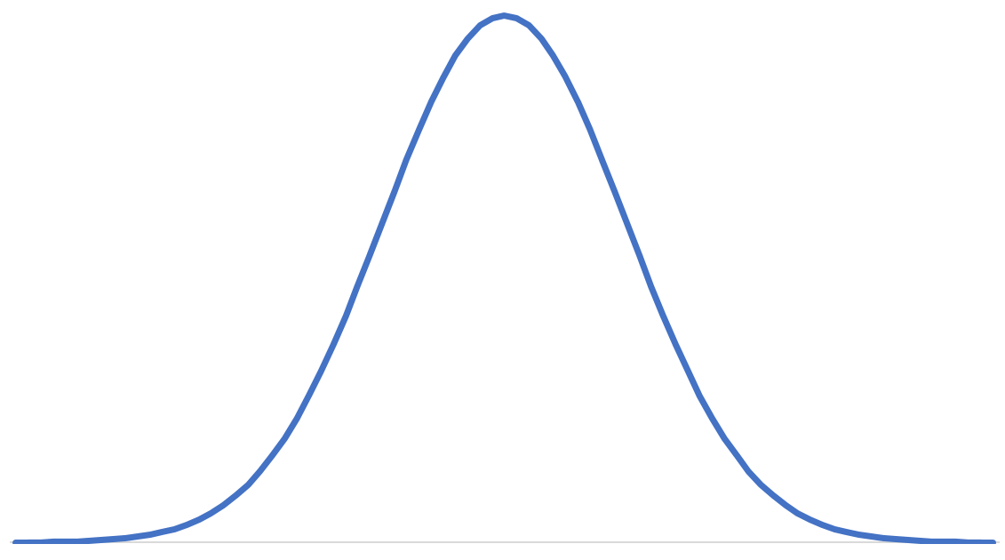
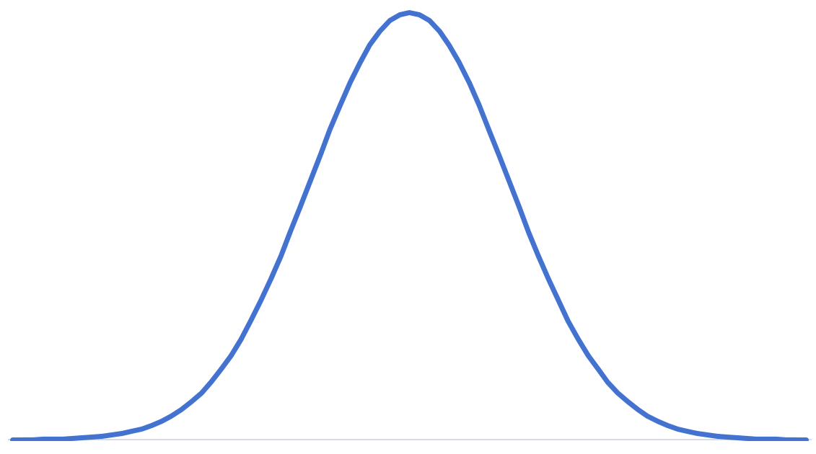
Our Construction: Analysis
Statistical distance between
Let this be $τ$
$T:$Random variable representing number of balls that the adversary sees twice = $ℓ.{(\frac{n−1}{n})}^{2}$ in expectation
$S:$Random variable representing number of balls that the adversary sees once
Left Bin
Right Bin
$S$ is the sum of $ℓ−τ$ Bernoulli trials with $p=\frac{(n−1)}{n}$
$S$is the same Bernoulli distribution but shifted by$θ\left(n\right)\frac{(n−1)}{n}$
$$σ_{2}=σ_{1}$$
$$σ_{1}=θ(\sqrt{ℓ}/n)$$
$$μ_{2}=μ_{1}+θ\left(n\right)$$
Gaussian Distribution
Gaussian Distribution

Slide 30
Our Construction: Analysis
Statistical distance between
Left Bin
$$σ=θ(\sqrt{ℓ}/n)$$
Right Bin
$$θ\left(n\right)$$
$$θ\left(n\right)$$
Statistical distance between two ”shifted” gaussian distributions
$1/poly(λ)$ when $ℓ=n^{4}.$ $poly(λ)$

Slide 31
Our Construction: Analysis
Statistical distance between
(over-simplified reasoning)
Left Bin
$$σ=θ(\sqrt{ℓ}/n)$$
Right Bin
$$θ\left(n\right)$$
$$θ\left(n\right)$$
uniform
Statistical distance between two ”shifted” gaussian distributions
over the support of size $θ(\sqrt{ℓ}/n)$
$SD=$ $θ\left(\frac{n}{\frac{\sqrt{ℓ}}{n}}\right)=$ $θ(n^{2}/\sqrt{ℓ})$
$=1/poly(λ)$ when $ℓ=n^{4}.poly(λ)$
$$θ\left(n\right)$$
$$θ\left(n\right)$$

Slide 32
Our Construction: Summary
Graph $G_{0}$
Graph $G_{1}$
Correctness:
In $G_{0},$each right vertex has even degree
..
..
Pseudorandomness:
In $G_{1},$ every left vertex has at least one unique right neighbor
$$s_{i}$$
$$s_{i}$$
..
.
..
.
Indistinguishability:
Subgraphs of $G_{0}$ and $G_{1}$ induced by any proper subset of the left vertices are indistinguishable
except with inverse poly error
$ℓ=n^{4}.$ $poly(λ)$
[BGI15] template
$$s_{i}^{∗}$$
..
Multiparty DPF with inverse poly privacy
$$t=θ(n)$$
Privacy Amplification [BGIK22]
Multiparty DPF

Slide 33
Open Problems
Efficiency Improvement
Variants
Applications
Reduce dependence on $n$
Potentially using computational assumptions
Thresholdized variant -- lower corruption threshold. Honest party’s shares sufficient for reconstruction.
Share sizes $o(\sqrt{|Domain|})$
Interesting even for small constant $n$
?
Multiparty FSS for related functions
Reduce dependence on $λ$
By potentially eliminating the need for privacy amplication

Slide 34
On Eprint!
Thanks!
aarushi@purdue.edu

