Slide 1
Stacking Zero-Knowledge Proofs for Disjunctions
Aarushi Goel
Based on joint works with:
Matthew Green (JHU), Mathias Hall-Andersen (Aarhus), Gabriel Kaptchuk (BU) and Nicholas Spooner (Warwick)

Slide 2
Zero Knowledge Proofs [GMR85]
$$L∈NP$$
$$x∈L$$
..
..
..
Prover
Okay, I believe you
Verifier

Slide 3
Zero Knowledge Proofs [GMR85]
Soundness
$$L∈NP$$
Cheating prover cannot give accepting proof if $x∉L$
$$x∈L$$
..
..
Zero knowledge
..
Verifier should not learn the secret witness
Prover
Verifier

Slide 4
Public-Coin Interactive Zero-Knowledge Proofs
$$L∈NP$$
$$x∈L$$
Verifier only sends random messages
..
Honest verifier zero-knowledge
..
$
..
Can be made non-interactive in the random oracle model [FS87]
Prover
Verifier

Slide 5
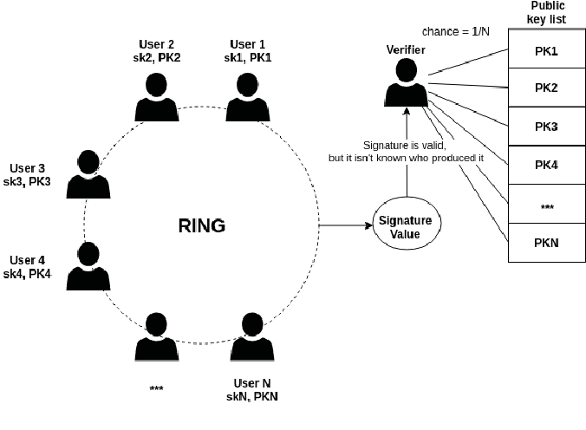
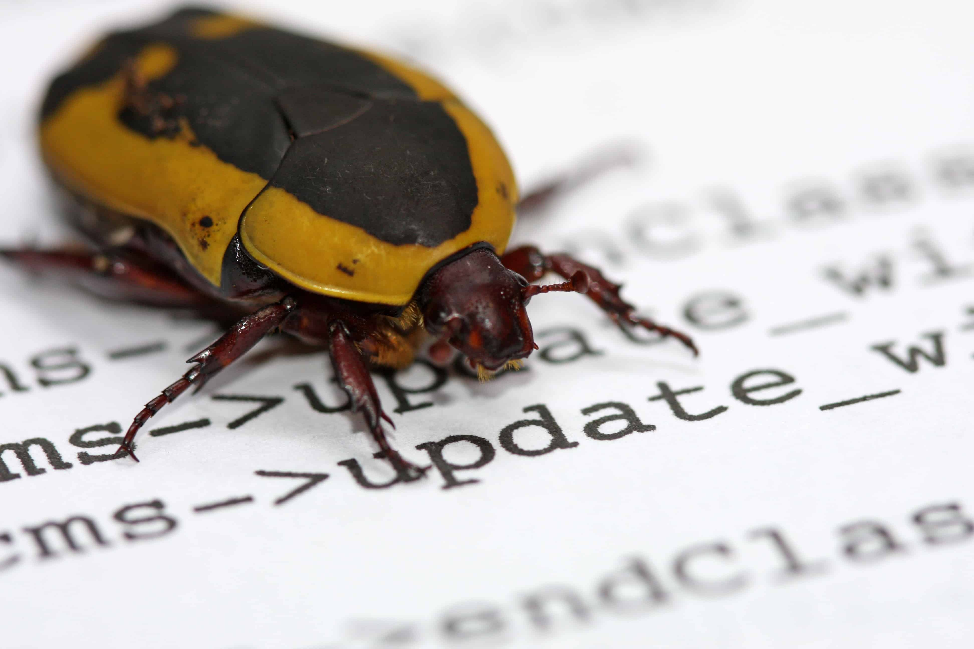
Disjunctive Statements
$$x_{1}∈L_{1}$$
$$or$$
$$x_{2}∈L_{2}$$
$$or$$
$$x_{3}∈L_{3}$$
$$or$$
$$x_{4}∈L_{4}$$
$$or$$
$$x_{5}∈L_{5}$$
$$or$$
$$x_{6}∈L_{6}$$
Why care about disjunctions?
Ring Signatures [RST01]
/Confidential Transactions
Proving existence of bugs in code [HK20]
Verifying authenticity of images in media [NT16]

Slide 6
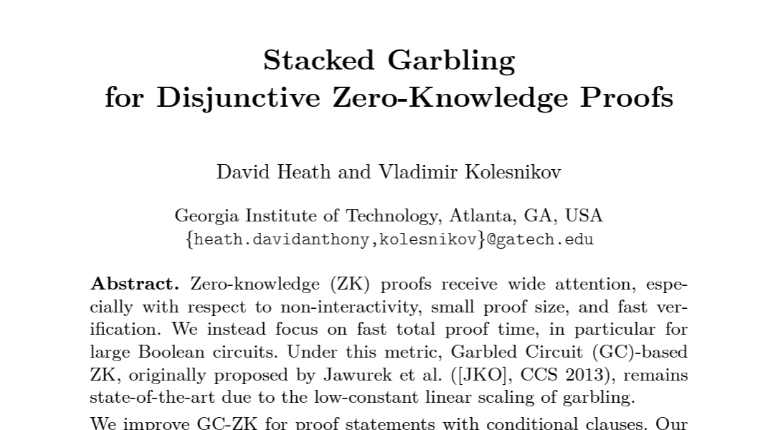
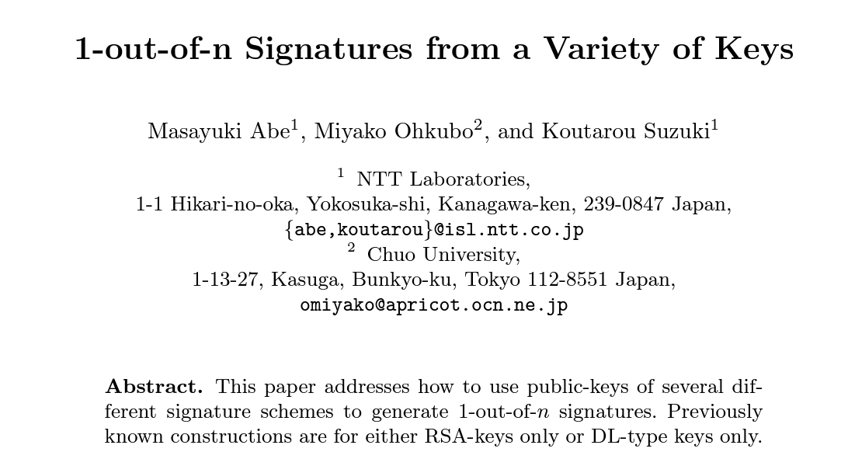
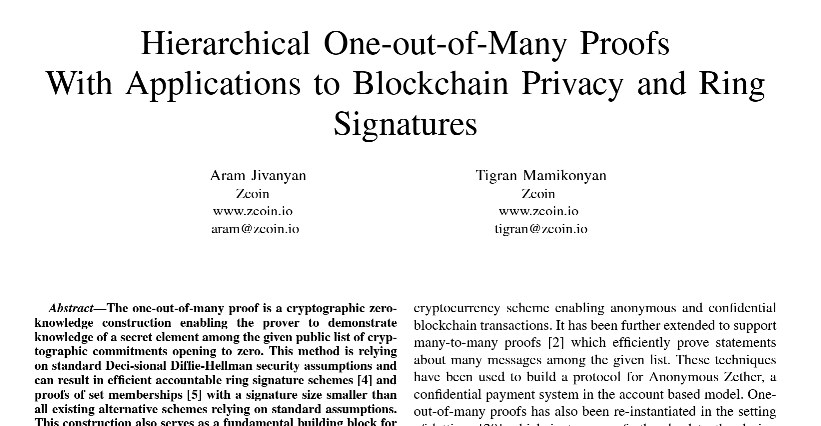
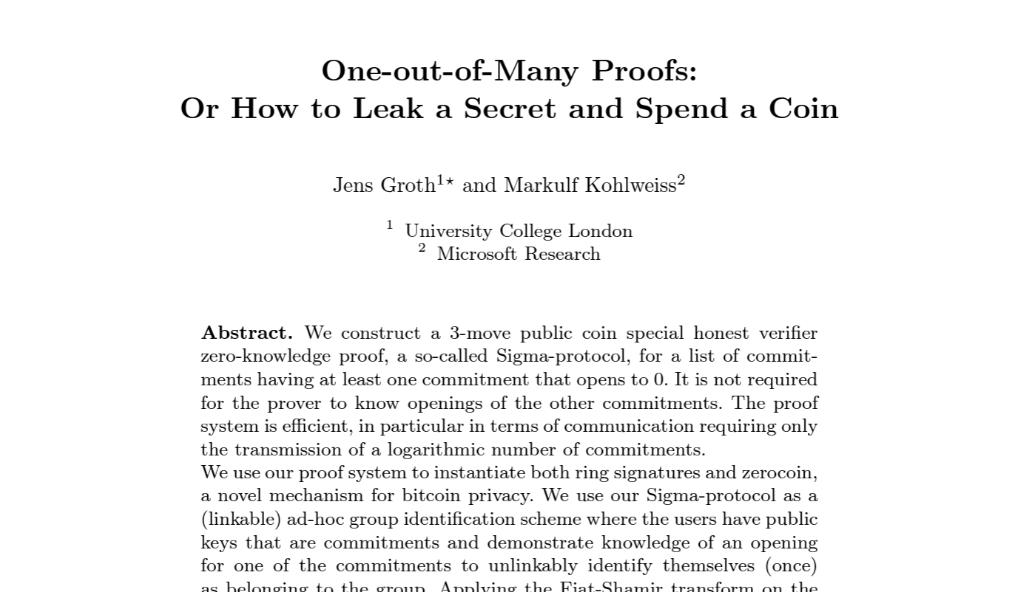
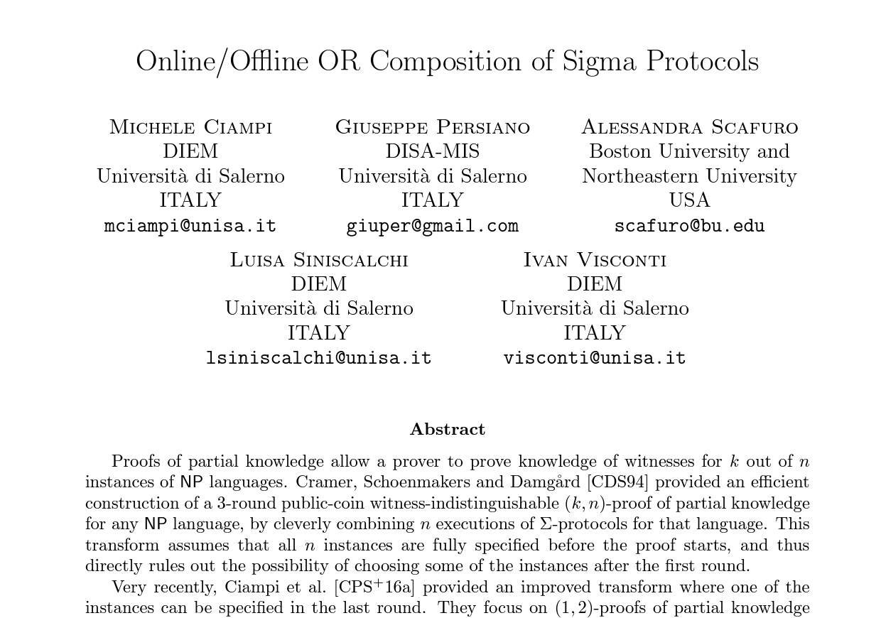
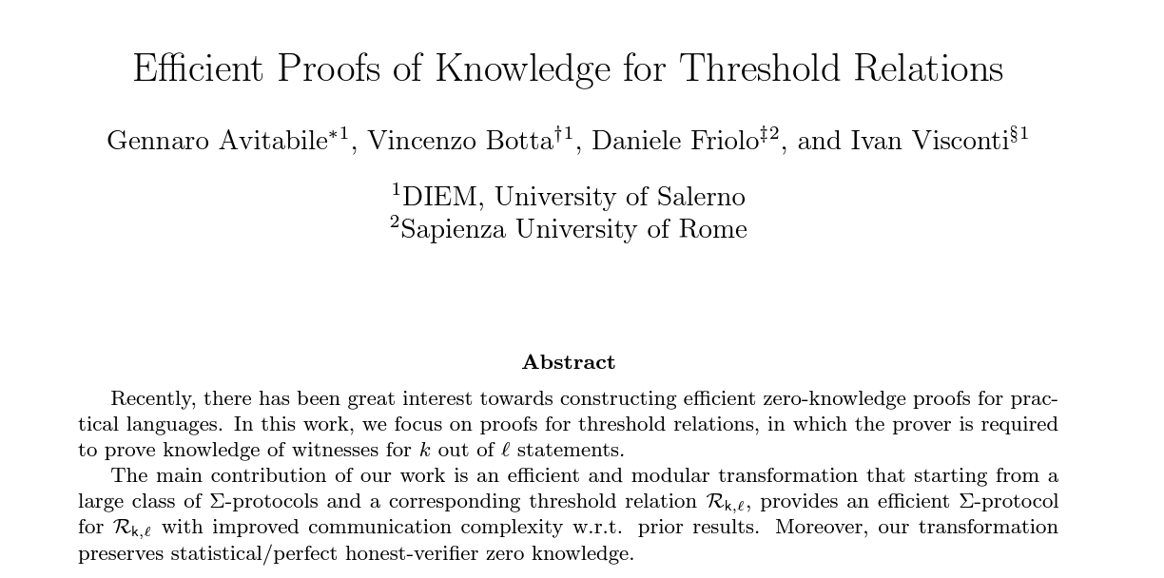
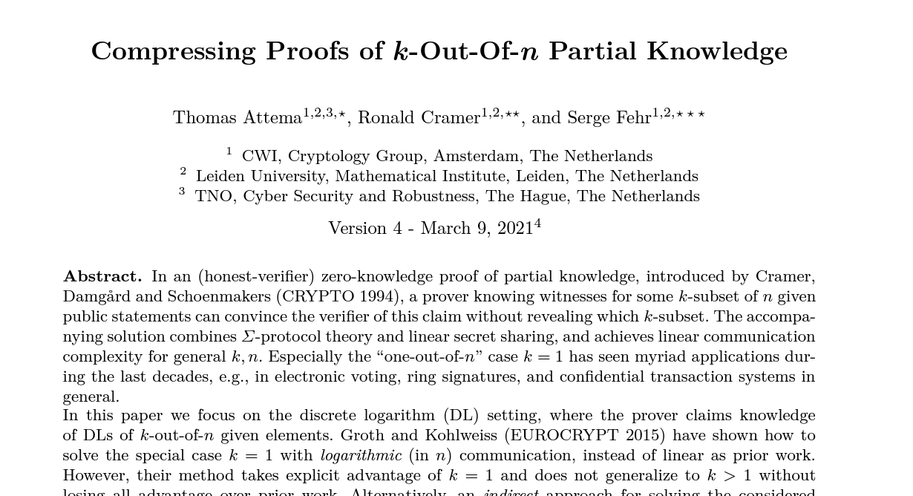
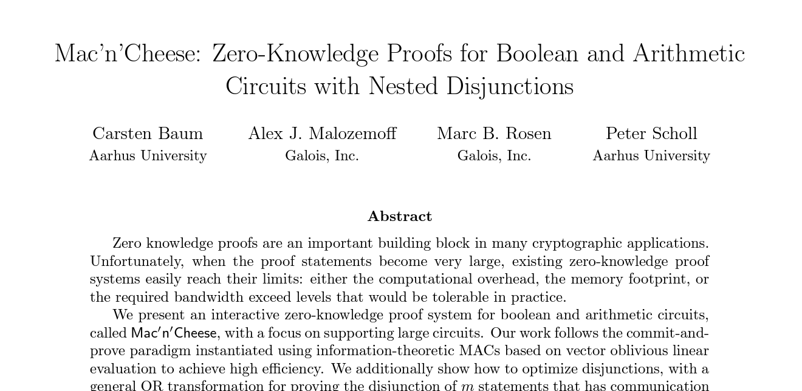
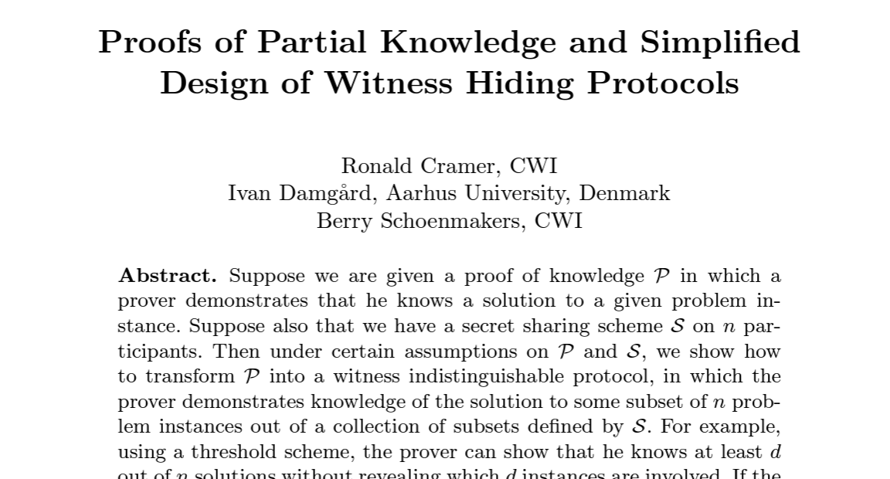
Lots of Work on Disjunctive Zero-Knowledge

Slide 7
Question?
Can we design a general framework to efficiently compose public-coin interactive zero-knowledge proofs for disjunctions?

Slide 8
Composing Public-Coin ZK-IP for Disjunctions
$$x_{1}∈L_{1}$$
$$x_{2}∈L_{2}$$
$$x_{3}∈L_{3}$$
$$x_{4}∈L_{4}$$
$$x_{5}∈L_{5}$$
$$x_{6}∈L_{6}$$
$$Π_{1}$$
$$Π_{2}$$
$$Π_{3}$$
$$Π_{4}$$
$$Π_{5}$$
$$Π_{6}$$

Slide 9
Composing Public-Coin ZK-IP for Disjunctions
$$x_{1}∈L_{1}$$
$$or$$
$$x_{2}∈L_{2}$$
$$or$$
$$x_{3}∈L_{3}$$
$$or$$
$$x_{4}∈L_{4}$$
$$or$$
$$x_{5}∈L_{5}$$
$$or$$
$$x_{6}∈L_{6}$$
$$Π_{6}$$
$$Π_{3}$$
$$Π_{2}$$
$$Π_{1}$$
$$Π_{5}$$
$$Π_{4}$$
New Proof

Slide 10
Composing Public-Coin ZK-IP for Disjunctions
$$x_{1}∈L_{1}$$
$$or$$
$$x_{2}∈L_{2}$$
$$or$$
$$x_{3}∈L_{3}$$
$$or$$
$$x_{4}∈L_{4}$$
$$or$$
$$x_{5}∈L_{5}$$
$$or$$
$$x_{6}∈L_{6}$$
$$Π_{6}$$
$$Π_{3}$$
$$Π_{2}$$
$$Π_{1}$$
$$Π_{5}$$
$$Π_{4}$$
[CDS94, AOS02]
$Σ$-Protocols
New Proof

Slide 11
Composing Public-Coin ZK-IP for Disjunctions
$$x_{1}∈L_{1}$$
$$or$$
$$x_{2}∈L_{2}$$
$$or$$
$$x_{3}∈L_{3}$$
$$or$$
$$x_{4}∈L_{4}$$
$$or$$
$$x_{5}∈L_{5}$$
$$or$$
$$x_{6}∈L_{6}$$
$$Π_{6}$$
$$Π_{6}$$
$$Π_{3}$$
$$Π_{3}$$
$$Π_{2}$$
$$Π_{2}$$
$$Π_{1}$$
$$Π_{1}$$
$$Π_{5}$$
$$Π_{5}$$
Our Goal
$$Π_{4}$$
[CDS94, AOS02]
$$Π_{4}$$
$Σ$-Protocols
New proof where size only depends on one clause
New Proof

Slide 12
Composing Public-Coin ZK-IP for Disjunctions
Stacking
$$x_{1}∈L_{1}$$
$$or$$
$$x_{2}∈L_{2}$$
$$or$$
$$x_{3}∈L_{3}$$
$$or$$
$$x_{4}∈L_{4}$$
$$or$$
$$x_{5}∈L_{5}$$
$$or$$
$$x_{6}∈L_{6}$$
$$Π_{6}$$
$$Π_{6}$$
$$Π_{3}$$
$$Π_{3}$$
$$Π_{2}$$
$$Π_{2}$$
$$Π_{1}$$
$$Π_{1}$$
$$Π_{5}$$
$$Π_{5}$$
Our Goal
$$Π_{4}$$
[CDS94, AOS02]
$$Π_{4}$$
$Σ$-Protocols
New proof where size only depends on one clause
New Proof

Slide 13
Our Results
Stacking $Σ$-Protocols [GGHK22]
Speed-Stacking [GHKS23]
General framework for stacking a large class of $Σ$-Protocols.
Extend stacking framework to
multi-round public-coin ZK-IP
Show that several existing $Σ$-Protocols are stackable.
Show that many existing sublinear proof systems are stackable
Resulting proof size = Proof size for a single clause + log (# clauses)
Resulting prover time = Prover time for a single branch + time to simulate remaining clauses
In sublinear proofs: Simulation time < Prover time
$⇒$Faster prover time for disjunctions

Slide 14
Stacking $Σ$-Protocols
[G-Green-Hall-Andersen-Kaptchuk 22]

Slide 15
Stacking $Σ$-Protocols for Disjunctions
$$x_{1}∈L_{1}$$
$$or$$
$$x_{2}∈L_{2}$$
$$or$$
$$x_{3}∈L_{3}$$
Prover has $w_{2}$
$$a_{1}$$
$$a_{2}$$
$$a_{3}$$
$$c_{1}$$
$$c_{2}$$
$$c_{3}$$
Prover
Verifier
$$z_{1}$$
$$z_{2}$$
$$z_{3}$$
$$Σ$$
$$Σ$$
$$Σ$$

Slide 16
Stacking $Σ$-Protocols for Disjunctions
$$x_{1}∈L_{1}$$
$$or$$
$$x_{2}∈L_{2}$$
$$or$$
$$x_{3}∈L_{3}$$
Prover has $w_{2}$
$$a_{1}$$
$$a_{2}$$
$$a_{3}$$
$$c$$
Prover
Verifier
$$z_{1}$$
$$z_{2}$$
$$z_{3}$$

Slide 17
Stacking $Σ$-Protocols for Disjunctions
$$x_{1}∈L_{1}$$
$$or$$
$$x_{2}∈L_{2}$$
$$or$$
$$x_{3}∈L_{3}$$
Prover has $w_{2}$
$$a_{1}$$
$$a_{2}$$
$$a_{3}$$
$$c$$
Prover
Verifier
$$z_{1}$$
$$z_{2}$$
$$z_{3}$$
??
Prover can compute these messages
??

Slide 18
Stacking $Σ$-Protocols for Disjunctions
$$x_{1}∈L_{1}$$
$$or$$
$$x_{2}∈L_{2}$$
$$or$$
$$x_{3}∈L_{3}$$
Prover has $w_{2}$
$$a_{1}$$
$$a_{2}$$
$$a_{3}$$
$$c$$
Prover
Verifier
$$z_{1}$$
$$z_{2}$$
$$z_{3}$$
Common simulation strategy in $Σ$-protocols:
Simulate
without $w_{1}$
Simulate
without $w_{3}$
Step 1:
Sample $c$
Step 2:
Compute $a, z$

Slide 19
Stacking $Σ$-Protocols for Disjunctions
How to simulate these messages?
$$x_{1}∈L_{1}$$
$$or$$
$$x_{2}∈L_{2}$$
$$or$$
$$x_{3}∈L_{3}$$
Prover has $w_{2}$
$$a_{1}$$
$$a_{2}$$
$$a_{3}$$
$$c$$
Prover
Verifier
$$z_{1}$$
$$z_{2}$$
$$z_{3}$$
Special Property 1:
Extended Honest Verifier ZK
Simulate
without $w_{1}$
Simulate
without $w_{3}$
Step 1:
Sample $c$
Step 2:
deterministic
Compute$z a$

Slide 20
Stacking $Σ$-Protocols for Disjunctions
$$x_{1}∈L_{1}$$
$$or$$
$$x_{2}∈L_{2}$$
$$or$$
$$x_{3}∈L_{3}$$
Prover has $w_{2}$
$$Com($$
$$)$$
$$⊥$$
$$a_{2}$$
$$⊥$$
$$c$$
Prover
Verifier
$$z_{1}$$
$$z_{2}$$
$$z_{3}$$
$$, op$$
Simulate ${(a}_{1},z_{1}),\left(a_{3},z_{3}\right)$
Compute $a_{1},a_{2}, a_{3}$using ${c,z}_{1},z_{2}, z_{3}$
$op=$ Equivocate $com$ to ${[a}_{1},a_{2}, a_{3}]$
Check if $com, op$ are consistent with ${[a}_{1},a_{2}, a_{3}]$
Check ${(x}_{1},a_{1},c,z_{1}),{(x}_{2},a_{2},c,z_{2}),$ ${(x}_{3},a_{3},c,z_{3})$

Slide 21
Partially-Binding Vector Commitments
$$Com($$
$$v_{1}$$
…..
$$)$$
$$v_{2}$$
$$v_{n}$$
$1$-out-of-$n$ position is binding. Rest can be equivocated.
Binding position is fixed at the time of commitment.
Binding position remains hidden from the receiver.
We propose an efficient construction based on Pedersen Commitments [Ped91]

Slide 22
Stacking $Σ$-Protocols for Disjunctions
$$x_{1}∈L_{1}$$
$$or$$
$$x_{2}∈L_{2}$$
$$or$$
$$x_{3}∈L_{3}$$
Prover has $w_{2}$
$$Com($$
$$)$$
$$⊥$$
$$a_{2}$$
$$⊥$$
$$c$$
Prover
Verifier
$$z_{1}$$
$$z_{2}$$
$$z_{3}$$
$$, op$$
Simulate ${(a}_{1},z_{1}),\left(a_{3},z_{3}\right)$
Compute $a_{1},a_{2}, a_{3}$using ${c,z}_{1},z_{2}, z_{3}$
$op=$ Equivocate $com$ to ${[a}_{1},a_{2}, a_{3}]$
Check if $com, op$ are consistent with ${[a}_{1},a_{2}, a_{3}]$
Check ${(x}_{1},a_{1},c,z_{1}),{(x}_{2},a_{2},c,z_{2}),$ ${(x}_{3},a_{3},c,z_{3})$
Have we saved on communication so far?

Slide 23
Stacking $Σ$-Protocols for Disjunctions
$$x_{1}∈L_{1}$$
$$or$$
$$x_{2}∈L_{2}$$
$$or$$
$$x_{3}∈L_{3}$$
Prover has $w_{2}$
$$Com($$
$$)$$
$$⊥$$
$$a_{2}$$
$$⊥$$
$$c$$
Prover
Verifier
$$z_{1}$$
$$z_{2}$$
$$z_{3}$$
$$, op$$
Simulate ${(a}_{1},z_{1}),\left(a_{3},z_{3}\right)$
Compute $a_{1},a_{2}, a_{3}$using ${c,z}_{1},z_{2}, z_{3}$
Can we recycle $z_{2}$?
$op=$ Equivocate $com$ to ${[a}_{1},a_{2}, a_{3}]$
Check if $com, op$ are consistent with ${[a}_{1},a_{2}, a_{3}]$
Check ${(x}_{1},a_{1},c,z_{1}),{(x}_{2},a_{2},c,z_{2}),$ ${(x}_{3},a_{3},c,z_{3})$
Special Property 2: (Recyclable third round message)
For a fixed $c$:
$z$ is similarly distributed for $x_{1},x_{2},x_{3}$

Slide 24
Stacking $Σ$-Protocols for Disjunctions
$$x_{1}∈L_{1}$$
$$or$$
$$x_{2}∈L_{2}$$
$$or$$
$$x_{3}∈L_{3}$$
Prover has $w_{2}$
$$Com($$
$$)$$
$$⊥$$
$$a_{2}$$
$$⊥$$
$$c$$
Prover
Verifier
$$z_{2}$$
$$, op$$
Simulate$a_{1},a_{3}$ using $c,z_{2}$
Compute $a_{1},a_{2}, a_{3}$using ${c,z}_{2}$
$op=$ Equivocate $com$ to ${[a}_{1},a_{2}, a_{3}]$
Check if $com, op$ are consistent with ${[a}_{1},a_{2}, a_{3}]$
Checks ${(x}_{1},a_{1},c,z_{2}),{(x}_{2},a_{2},c,z_{2}),$ ${(x}_{3},a_{3},c,z_{2})$

Slide 25
Stacked $Σ$-Protocol for Disjunctions
$$x_{1}∈L_{1}$$
$$or$$
$$x_{2}∈L_{2}$$
$$or$$
$$x_{3}∈L_{3}$$
Prover has $w_{2}$
$$Com($$
$$)$$
$$⊥$$
$$a_{2}$$
$$⊥$$
$$c$$
Prover
Verifier
$$z_{2}$$
$$, op$$
Communication = proof size for proving a single branch + size of commitment + size of opening
Can be short
At least linear in the length of the vector
Can be made logarithmic!!

Slide 26
Examples of Stackable $Σ$-Protocols
Many natural sigma protocols are stackable
Example 1:
Schnorr’s $Σ$-Protocol [Sch90]
Example 2:
Graph 3-coloring
Example 3:
Hamiltonian Cycle [Blu87]
MPC-in-the-head [IKOS07]
Example 4:
(Including Ligero [AHIV17] , [KKW18] used in Picnic)
$and many more$…..

Slide 27
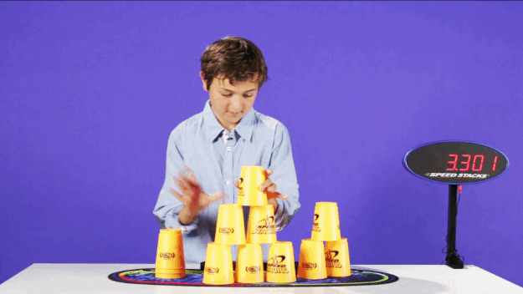
Speed-Stacking
[G-Hall-Andersen-Kaptchuk-Spooner 23]

Slide 28
Review: Stacking approach for $Σ$-Protocols
Deterministically computable given $x,c,z$
$$a$$
$$c$$
$$z$$
Prover
Recyclable across clauses
Verifier

Slide 29
Multi-Round ZK-IP
Which messages are recyclable and which ones are deterministically computable?
$$x∈L$$
$$m_{1}$$
$$c_{1}$$
$$m_{2}$$
Prover
Verifier
$$c_{2}$$
.
.
.
$$m_{k}$$

Slide 30
Multi-Round ZK-IP
$$x∈L$$
$m_{rand,1}$ $m_{det,1}$
$$c_{1}$$
$m_{rand,2}$ $m_{det,2}$
Prover
Verifier
$$c_{2}$$
.
.
.
Can be simulated independent of the instance $x$ and hence are recyclable!
Can be computed deterministically, given the instance $x$ and $m_{rand}$ messages
$m_{rand,k}$ $m_{det,k}$

Slide 31
Stacking Multi-Round ZK-IP
$$x_{1}∈L_{1}$$
$$or$$
$$x_{2}∈L_{2}$$
$$or$$
$$x_{3}∈L_{3}$$
Prover has $w_{2}$
$$m_{rand,11}$$
$$m_{det,11}$$
$$m_{rand,21}$$
$$m_{det,21}$$
$$m_{rand,31}$$
$$m_{det,31}$$
$$c_{11}$$
$$c_{21}$$
$$c_{31}$$
$$m_{rand,12}$$
$$m_{det,12}$$
$$m_{rand,22}$$
$$m_{det,22}$$
$$m_{rand,32}$$
$$m_{det,32}$$
Prover
Verifier
$$c_{12}$$
$$c_{22}$$
$$c_{32}$$
.
.
.
.
.
.
.
.
.
$$m_{rand,1k}$$
$$m_{det,1k}$$
$$m_{rand,2k}$$
$$m_{det,2k}$$
$$m_{rand,3k}$$
$$m_{det,3k}$$
$${Π }_{1}$$
$${Π }_{2}$$
$${Π }_{3}$$

Slide 32
Stacking Multi-Round ZK-IP
$$x_{1}∈L_{1}$$
$$or$$
$$x_{2}∈L_{2}$$
$$or$$
$$x_{3}∈L_{3}$$
Prover has $w_{2}$
$$m_{rand,11}$$
$$m_{det,11}$$
$$m_{rand,21}$$
$$m_{det,21}$$
$$m_{rand,31}$$
$$m_{det,31}$$
$$c_{1}$$
$$m_{rand,12}$$
$$m_{det,12}$$
$$m_{rand,22}$$
$$m_{det,22}$$
$$m_{rand,32}$$
$$m_{det,32}$$
Prover
Verifier
$$c_{2}$$
.
.
.
.
.
.
.
.
.
$$m_{rand,1k}$$
$$m_{det,1k}$$
$$m_{rand,2k}$$
$$m_{det,2k}$$
$$m_{rand,3k}$$
$$m_{det,3k}$$

Slide 33
Stacking Multi-Round ZK-IP
$$x_{1}∈L_{1}$$
$$or$$
$$x_{2}∈L_{2}$$
$$or$$
$$x_{3}∈L_{3}$$
Prover has $w_{2}$
$$m_{rand,21}$$
, $Com($
$$⊥$$
$$m_{det,21}$$
$$⊥$$
$$)$$
$$c_{1}$$
$$m_{rand,22}$$
, $Com($
$$⊥$$
$$m_{det,22}$$
$$⊥$$
$$)$$
Prover
Verifier
$$c_{2}$$
.
.
.
Before the last round:
Simulate all remaining deterministic messages
Equivocate all commitments to the updated vectors
$$m_{rand,2k}$$
$${op}_{1},…,{op}_{k−1}$$

Slide 34
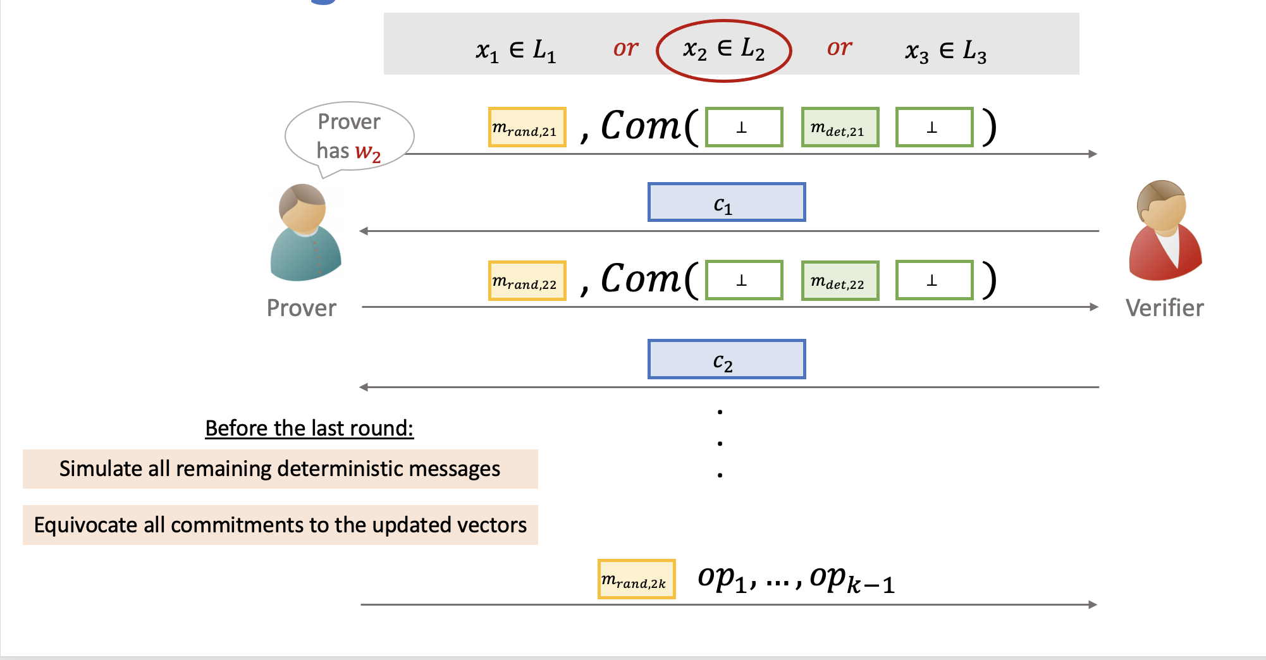
Complexity Analysis
Communication = proof size for proving a single branch + $k ×$size of commitment + size of openings
Computation time = time to prove a single branch + $\text{time} \text{to} \text{compute}$deterministic messages for all branches
If time to simulate $m_{det,ij}$ << time to prove a single branch: We can get sublinear computation times

Slide 35
Examples of Stackable Multi-round ZK-IP
Many sublinear proof systems!
Folding Arguments
Interactive Oracle Proofs
Stactal
[GHKS23]
Bulletproofs
[BBBPWM18]
Compressed Σ-Protocols
[AC20, ACF21]
Aurora
[BCRSVW19]
Fractal
[COS20]
No meaningful speedup
Sim same speed as prover
No asymptotic speedup
Significant concrete speedup
Sim only field operations
Small asymptotic speedup
Significant concrete speedup
Re-use low-degree test across clauses
Design non-trivial extension with constant time simulation
Significant asymptotic speedup

Slide 36
Conclusion
Stacking $Σ$-Protocols [GGHK22]
Speed-Stacking [GHKS23]
General framework for stacking a large class of $Σ$-Protocols.
Extend stacking framework to
multi-round public-coin ZK-IP
Resulting proof size = Proof size for a single clause + log (# clauses)
In sublinear proofs: Simulation time < Prover time
$⇒$Faster prover time for disjunctions

Slide 37
Thanks! https://eprint.iacr.org/2021/422.pdf https://eprint.iacr.org/2022/1419.pdf

