Slide 1
Zero-Knowledge Proofs of Training
Aarushi Goel
Joint work with:
Sanjam Garg (UC Berkeley & NTT Research), Somesh Jha (UW-Madison), Saeed Mahloujifar (Meta),
Mohammad Mahmoody (UVA), Guru Vamsi Policharla (UC Berkeley) and Mingyuan Wang (UC Berkeley)

Slide 2
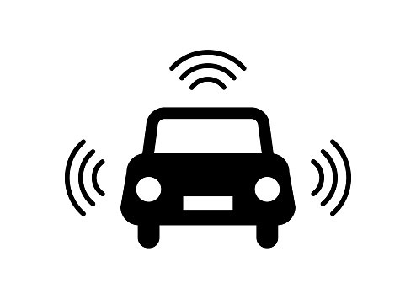
Machine Learning
Applications
Training
Online Fraud Detection
Medical Diagnosis
Training Data
Trained Model
Inference
Self Driving Cars
Virtual Personal Assistant
New Data
Result
Speech Recognition
and many more...

Slide 3
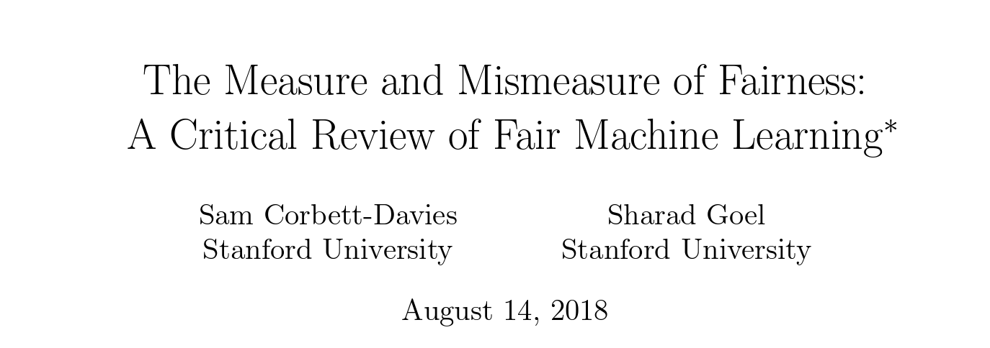
Security Concerns (Few Examples)
Model Stealing
Deviating from Specification

Slide 4
Security Concerns (Few Examples)
Model Stealing
Deviating from Specification
Can we give a proof of ownership and honest training?

Slide 5
Proof of Training (PoT)
Model Trainer
Verifier
Checks if
is a valid proof.
1.
How does the verifier check?
[JYCDTCP21]
2.
Generates a proof
attesting that
training was done according to the specifications of the learning algorithm.
Can we reveal the data and model?
Notes:
.

Slide 6
Can We Reveal the Data and Model?
Model Stealing
Deviating from Specification
Exposing the dataset could render the proof irrelevant if the aim of PoT was to e.g. demonstrate privacy of model training.
Revealing the data/model could be self-defeating!
Notes:
.

Slide 7
Can we give a proof of training while keeping the data and model private?

Slide 8
Zero-Knowledge (zk) Proofs [GMR85]
$∃w,$ s.t.,
$$x=f(w)$$
Zero knowledge
Verifier should not learn the secret $w$
$$π$$
Soundness
Okay, I believe you
Verifier
Cheating prover cannot give accepting proof if $∄w,$ s.t.,
$$x≠f(w)$$
Prover
$x,f$ are public inputs
$w$ is private

Slide 9
Zero-Knowledge Proof of Training (zkPoT)
Data
Model
Model Trainer/Prover
Verifier
1.
Checks if
is a valid proof,
w.r.t.
Data
Model
2.
Data
Model
These boxes are cryptographic commitments!
3.
Generates a proof
attesting that
Ideally, we want the communication and verification time to be sublinear in the time taken to do the training!
training was done according to the specifications of the learning algorithm.

Slide 10
Why is zkPoT a Useful Notion?
We can prove additional properties about data using existing ZK-Proofs
Data
When making inference queries to this model, we can use proof of inference [LQQO20, FQZDC21, LXZ21] to prove that the model in the box is the one that was used for inference calls
Model

Slide 11
Can we use existing zk-proofs for realizing zkPoT?
Yes! (Theoretically)
Can we really use existing zk-proofs for realizing zkPoT?
No! (Concretely Very Inefficient – Lack of Scalability)

Slide 12
State-of-the-Art ZK Proof Systems
zkSNARKs
MPC-in-the-Head
Proof Size
Small
Large
Verification
Fast
Slow
Proof Generation
Slow
Fast
Non-arithmetic Operations
No
Yes
Streaming Friendly
No
Yes

Slide 13
Our Approach
MPC-in-the-Head
zkSNARKs
(Logistic Regression)
Proof Size
Small
Only depends on the number of records in the dataset, not on the number of features
Verification
Fast
Offline Phase (Independent of Data)
+
Online Phase (Dependent on Data)
Proof Generation
Fast
Non-arithmetic Operations
Yes
Using fixed-point arithmetic
Streaming Friendly
Yes

Slide 14
Conclusion
Formalize a notion of zero-knowledge proof of training (zkPoT).
Design a protocol for generating zkPoT for linear models trained using logistic regression by combining techniques from zk-SNARKs and MPC-in-the-head.
When training with 1 million datasets with 1024 features, our protocol takes about an hour on a local laptop on a single threaded CPU.

Slide 15
Thanks!
aarushi.goel@ntt-research.com
https://aarushigoel.github.io/

