Slide 1
Zero-Knowledge SNARKs as a Service
zkSaaS
Sanjam Garg
Aarushi Goel
Abhishek Jain
Guru Vamsi Policharla
Sruthi Sekar

Slide 2
zk-SNARKs: Zero-Knowledge Succinct Non-Interactive Arguments of Knowledge
$$L∈NP$$
$$x∈L$$
$$π$$
Prover
Okay, I believe you
Verifier

Slide 3
zk-SNARKs: Zero-Knowledge Succinct Non-Interactive Arguments of Knowledge
$$L∈NP$$
$$x∈L$$
$$π$$
Prover
Okay, I believe you
Verifier
Anyone can verify

Slide 4
zk-SNARKs: Zero-Knowledge Succinct Non-Interactive Arguments of Knowledge
Zero knowledge
$$L∈NP$$
Verifier should not learn the secret witness
$$x∈L$$
$$π$$
Prover
Okay, I believe you
Verifier
Anyone can verify

Slide 5
zk-SNARKs: Zero-Knowledge Succinct Non-Interactive Arguments of Knowledge
Zero knowledge
$$L∈NP$$
Verifier should not learn the secret witness
$$x∈L$$
Soundness
$$π$$
Cheating prover cannot give accepting proof if $x∉L$
Prover
Okay, I believe you
Verifier
Anyone can verify

Slide 6
zk-SNARKs: Zero-Knowledge Succinct Non-Interactive Arguments of Knowledge
Zero knowledge
$$L∈NP$$
Verifier should not learn the secret witness
$$x∈L$$
Soundness
$$π$$
Cheating prover cannot give accepting proof if $x∉L$
Okay, I believe you
Verifier
Succinctness
Prover
Time to verify is smaller than time to compute
Anyone can verify

Slide 7
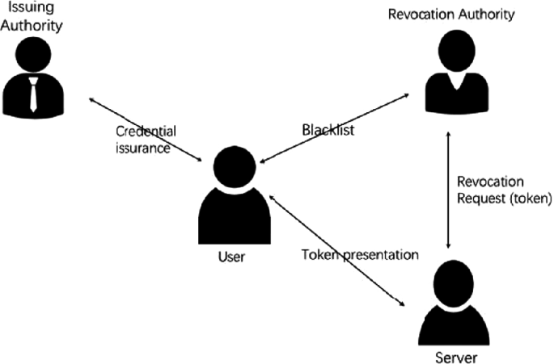
zk-SNARKs: Numerous Applications
Anonymous Credentials [Chaum82]
Verifiable Inference of Machine Learning [LKKO20]
Private Smart Contracts [BCGMMW20]
Proving existence of bugs in code [HK20]
Verifying authenticity of images in media [NT16]
Privacy Respecting Cryptocurrency [BCGGMTV14]

Slide 8
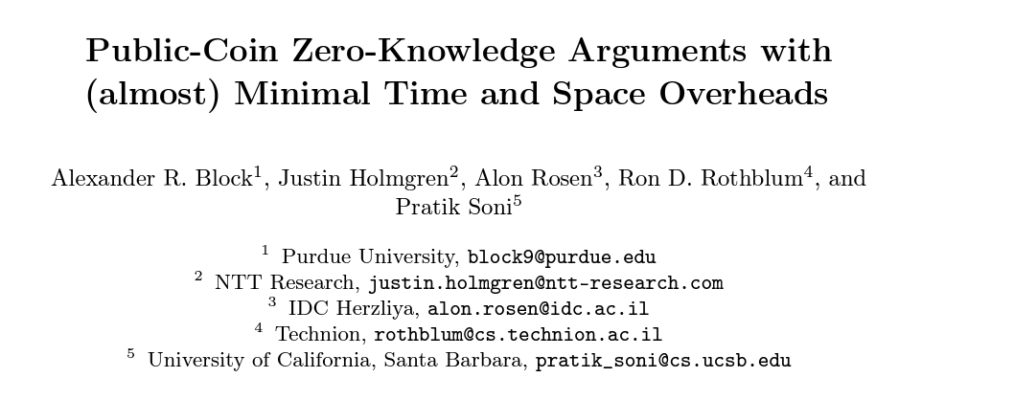
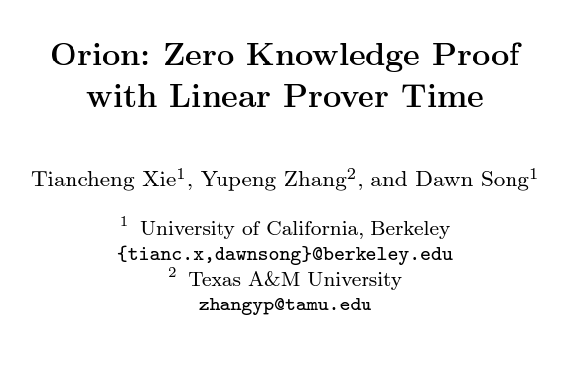
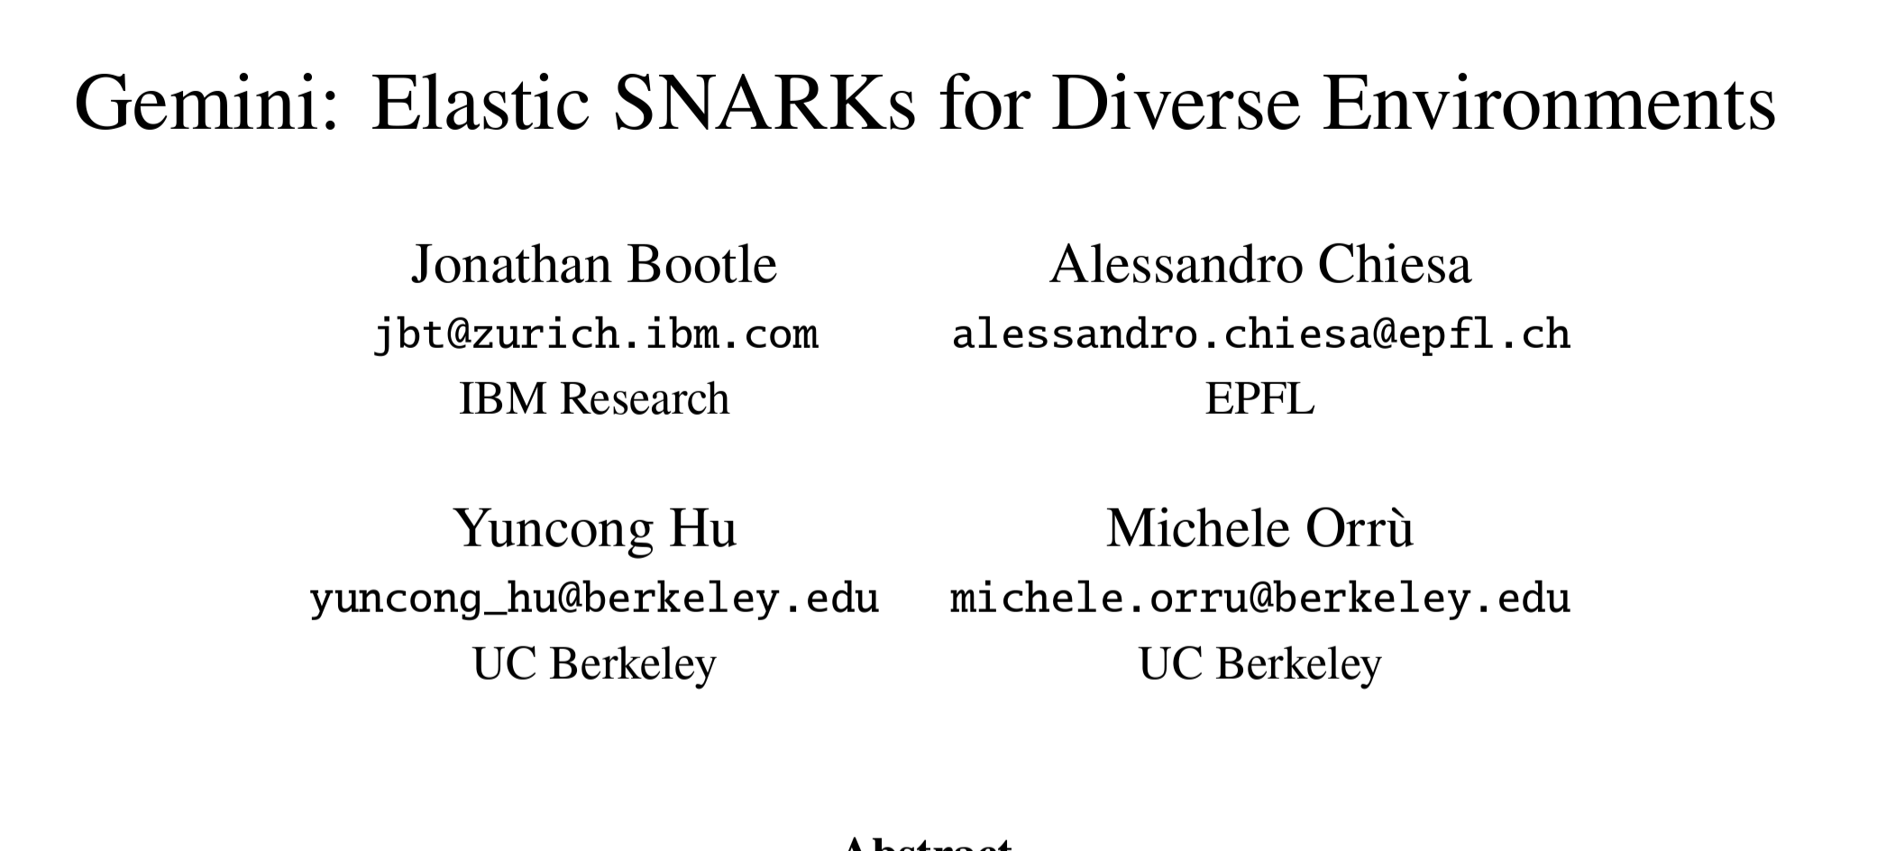
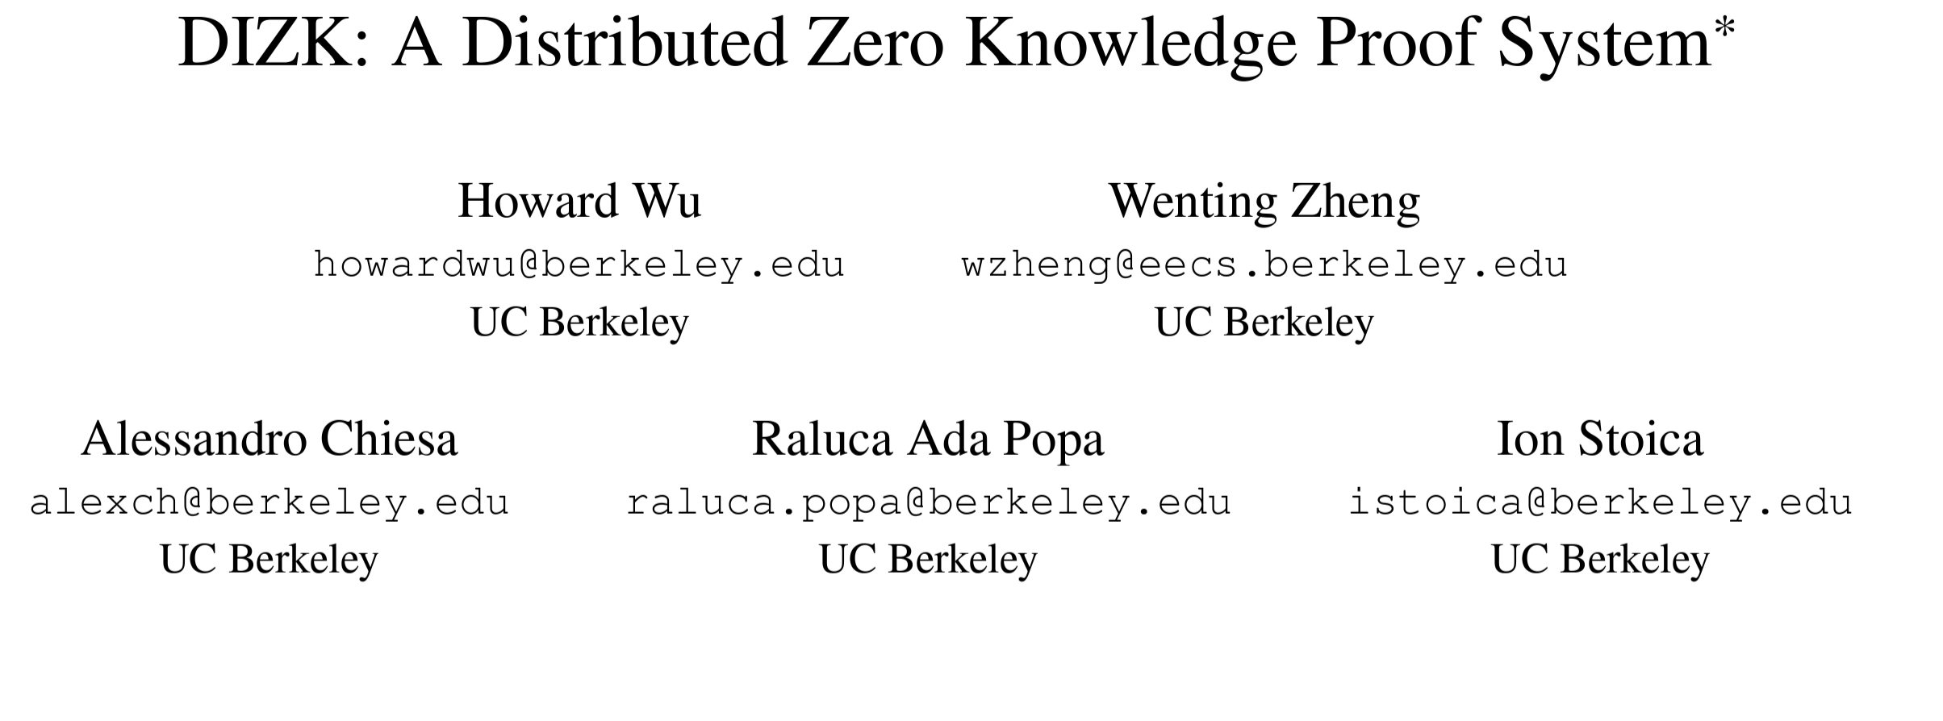
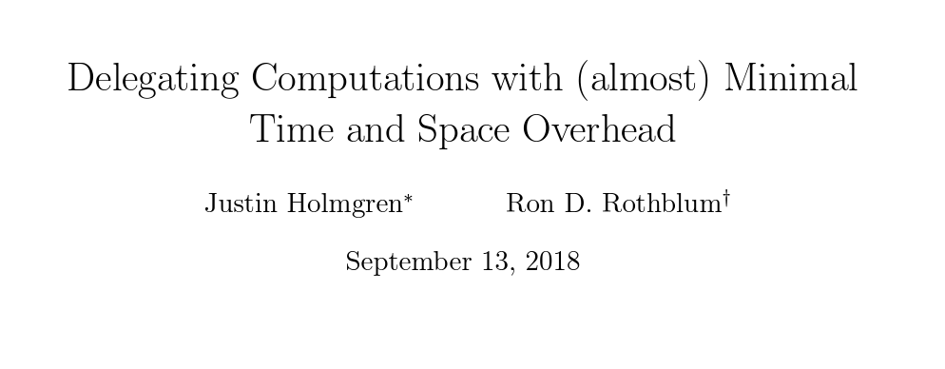
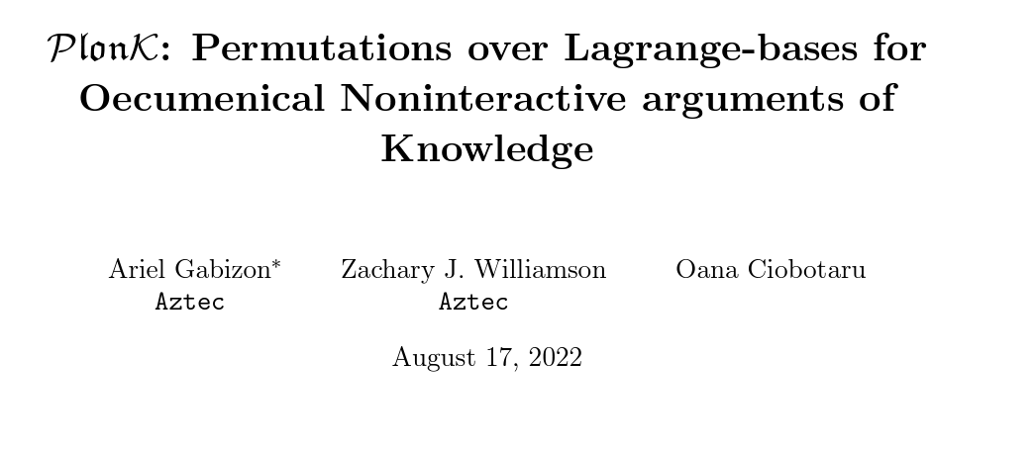
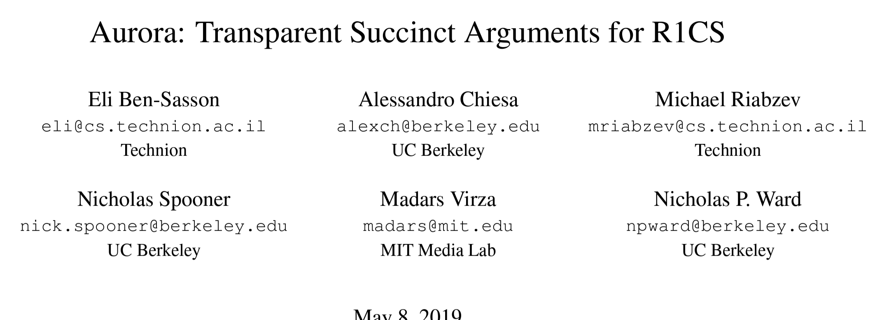
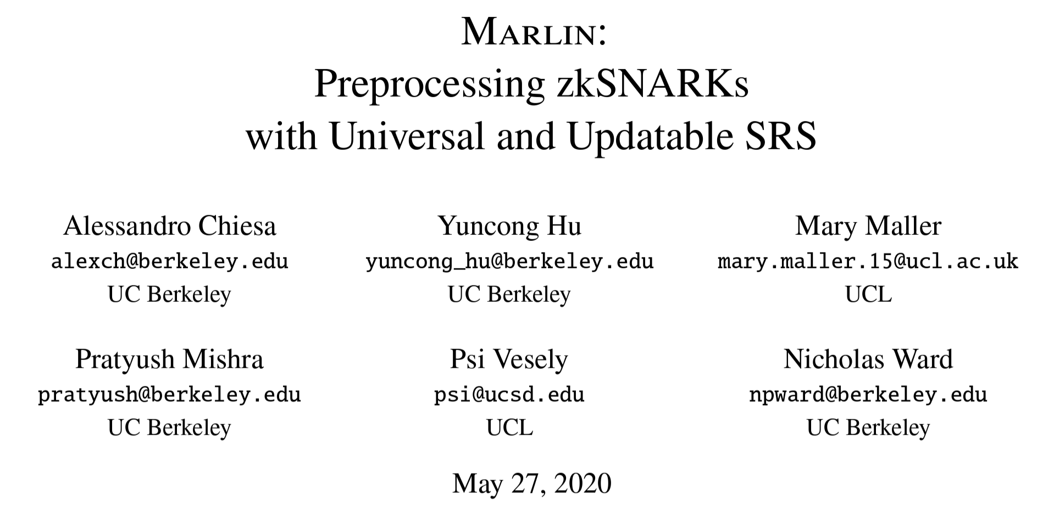
zk-SNARKs: Lots of Work on Improving Efficiency
Time to generate of zk-SNARKs >>> Time to check the relation directly

Slide 9
Gru’s Quest to be a Supervillain
Since Gru has a very long list of despicable achievements, computing a zk-SNARK will take a really long time
Prove this in zero-knowledge
I am a great villain and deserve to be part of Vicious 6
Gru: Rising Villain
Vicious 6: A prolific set of Supervillains

Slide 10
Can Gru Delegate zk-SNARK Computation?
Violates Privacy!!: Requires leaking the entire witness to AWS
Details of his despicable achievements
$$π$$
zk-SNARK attesting to his achievements
$$π$$
Gru: Rising Villain
Vicious 6: A prolific set of Supervillains

Slide 11
Can Gru Delegate zk-SNARK Computation?
Delegate to a group of minions who run an MPC to compute the zk-SNARK
Each minion only gets a share of the witness
Details of his despicable achievements
$$π$$
$$π$$
Gru: Rising Villain
Vicious 6: A prolific set of Supervillains

Slide 12
Can Gru Delegate zk-SNARK Computation?
Delegate to a group of minions who run an MPC to compute the zk-SNARK
Each minion only gets a share of the witness
Details of his despicable achievements
$$π$$
Collaborative zk-SNARKs [OB22]
$$π$$
Gru: Rising Villain
Vicious 6: A prolific set of Supervillains

Slide 13
Prior Work: Collaborative zk-SNARKs [OB22]
Efficient MPC for computing zk-SNARKs – great of privacy
Each party does work proportional to a single prover – seems wasteful
[WZCAS18] leverage parallelism to distribute work across machines in a compute cluster to get faster proof generation – not privacy preserving
Notes:
\

Slide 14
Our Goal:
Better utilization of resources of the parties in collaborative zk-SNARKs, for faster proof generation, in a privacy-preserving manner

Slide 15
Our Results
Framework
zkSaaS: General framework for privacy preserving delegation of zk-SNARK computation. Each servers is expected to run for a shorter duration than a single local prover.
Design
Design zkSaaS to obtain faster runtimes than local provers for widely used zk-SNARKs, such as Groth16 [Gro16], Marlin [CHMMVW20] and Plonk [GWC19].
Implement a prototype of zkSaaS for Groth16 and get
≈ 22× speed-up whenrun with 128 parties for 225 constraints
Implementation
Notes:
Say …

Slide 16
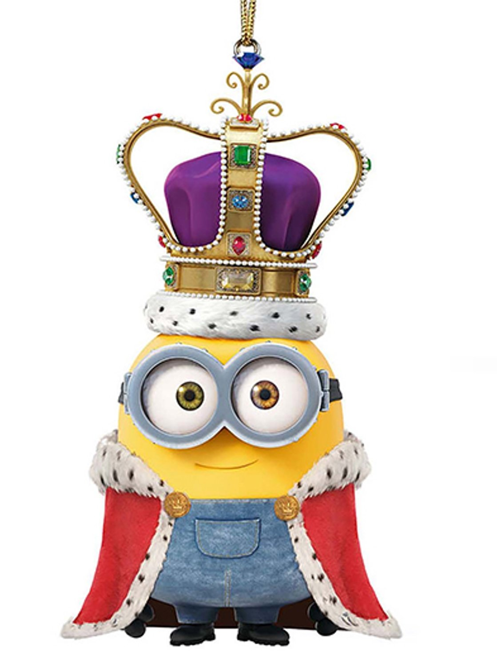
zkSaaS Framework
Typical zk-SNARKs
Step 1: Computing Extended Witness
Step 2: Generating Proof
(Cryptographic Operations + Field Operations)
Pre-Processing: each server gets a part of the correlated randomness
Secret Share ”Extended Witness”
Cryptographic Operations get equally divided amongst all servers
$$π$$
Field Operations get equally divided amongst small servers. King does work linear in the number of field operations.
Client compute Step 1
Servers collectively compute Step 2

Slide 17
Example Applications of zkSaaS
To aid users with small devices
For extremely large computations
Private Transactions and Smart Contracts
Combating Disinformation
Statements involving Ethereum Wallets
Verifiable Private ML Inference

Slide 18
Designing zkSaaS

Slide 19
General Template [OB22]
Identify basic building blocks in zk-SNARKs
+
Design custom MPC protocols for each building block with the required efficiency
Combine them to get a zkSaaS for the corresponding zk-SNARK
Notes:
]

Slide 20
Building Blocks in Groth16, Marlin, Plonk
Multi-Scalar Multiplications (MSM)
Partial Products
$$F\left(g_{1},α_{1},…,{g_{m},α}_{m}\right)=\prod_{i∈[m]}{{g_{i}}^{α_{i}}}$$
$$F\left(x_{1},…,x_{m}\right)={\left(\prod_{i∈[j]}{x_{i}}\right)}_{j∈[m]}$$
Fast Fourier Transform (FFT)
Polynomial Multiplication and Division
For converting between coefficient and evaluation representation of polynomials
A combination of addition, multiplication and FFT operations

Slide 21
Packed Secret Sharing (PSS) [FY92]
Secret value
$$v$$
shares
$$s_{1}$$
$$s_{2}$$
$$s_{3}$$
$$s_{4}$$
$$s_{5}$$
Regular Secret Sharing
1 Value $→n$ shares
Corruption threshold: $t<\frac{n}{2}$

Slide 22
Packed Secret Sharing (PSS) [FY92]
Secret value
$$v$$
$$v_{1}$$
$$v_{2}$$
$$v_{3}$$
$$v_{4}$$
Secret vector
shares
$$s_{1}$$
$$s_{2}$$
$$s_{3}$$
$$s_{4}$$
$$s_{5}$$
$$s_{1}$$
$$s_{2}$$
$$s_{3}$$
$$s_{4}$$
$$s_{5}$$
shares
Regular Secret Sharing
Packed Secret Sharing
1 Value $→n$ shares
$O(n)$ Values $→n$ shares
Corruption threshold: $t<\frac{n}{2}$

Slide 23
Packed Secret Sharing (PSS) [FY92]
Secret value
$$v$$
$$v_{1}$$
$$v_{2}$$
$$v_{3}$$
$$v_{4}$$
Secret vector
shares
$$s_{1}$$
$$s_{2}$$
$$s_{3}$$
$$s_{4}$$
$$s_{5}$$
$$s_{1}$$
$$s_{2}$$
$$s_{3}$$
$$s_{4}$$
$$s_{5}$$
shares
Regular Secret Sharing
Packed Secret Sharing
1 Value $→n$ shares
$O(n)$ Values $→n$ shares
Corruption threshold: $t<\frac{n}{2}$
Corruption threshold $t<n(\frac{1}{2}−$ $\frac{1}{ε})$

Slide 24
Computing using PSS
$$U=$$
$$u_{1}$$
$$u_{2}$$
$$u_{3}$$
$$u_{4}$$
$$s_{1}$$
$$s_{2}$$
$$s_{3}$$
$$s_{4}$$
$$s_{5}$$
Packed Secret Sharing
$$𝒱=$$
$$v_{1}$$
$$v_{2}$$
$$v_{3}$$
$$v_{4}$$
$$r_{1}$$
$$r_{2}$$
$$r_{3}$$
$$r_{4}$$
$$r_{5}$$

Slide 25
Computing using PSS
$$U=$$
$$u_{1}$$
$$u_{2}$$
$$u_{3}$$
$$u_{4}$$
$$s_{1}$$
$$s_{2}$$
$$s_{3}$$
$$s_{4}$$
$$s_{5}$$
Packed Secret Sharing
$$𝒱=$$
$$v_{1}$$
$$v_{2}$$
$$v_{3}$$
$$v_{4}$$
$$r_{1}$$
$$r_{2}$$
$$r_{3}$$
$$r_{4}$$
$$r_{5}$$
Addition
$$s_{1}+r_{1}$$
$$s_{1}+r_{1}$$
$$s_{1}+r_{1}$$
$$s_{1}+r_{1}$$
$$s_{1}+r_{1}$$

Slide 26
Computing using PSS
$$U=$$
$$u_{1}$$
$$u_{2}$$
$$u_{3}$$
$$u_{4}$$
$$s_{1}$$
$$s_{2}$$
$$s_{3}$$
$$s_{4}$$
$$s_{5}$$
Packed Secret Sharing
$$𝒱=$$
$$v_{1}$$
$$v_{2}$$
$$v_{3}$$
$$v_{4}$$
$$r_{1}$$
$$r_{2}$$
$$r_{3}$$
$$r_{4}$$
$$r_{5}$$
Addition
$$s_{1}+r_{1}$$
$$s_{1}+r_{1}$$
$$s_{1}+r_{1}$$
$$s_{1}+r_{1}$$
$$s_{1}+r_{1}$$
$t$-out-of-$n$Packed sharing of:
$$u_{1}+v_{1}$$
$$u_{2}+v_{2}$$
$$u_{3}+v_{3}$$
$$u_{4}+v_{4}$$

Slide 27
Computing using PSS
$$U=$$
$$u_{1}$$
$$u_{2}$$
$$u_{3}$$
$$u_{4}$$
$$s_{1}$$
$$s_{2}$$
$$s_{3}$$
$$s_{4}$$
$$s_{5}$$
Packed Secret Sharing
$$𝒱=$$
$$v_{1}$$
$$v_{2}$$
$$v_{3}$$
$$v_{4}$$
$$r_{1}$$
$$r_{2}$$
$$r_{3}$$
$$r_{4}$$
$$r_{5}$$
Addition
Multiplication
$$s_{1}+r_{1}$$
$$s_{1}+r_{1}$$
$$s_{1}+r_{1}$$
$$s_{1}+r_{1}$$
$$s_{1}+r_{1}$$
$$s_{1 }× r_{1}$$
$$s_{1 }×{ r}_{1}$$
$$s_{1} ×{ r}_{1}$$
$$s_{1 }×{ r}_{1}$$
$$s_{1} ×{ r}_{1}$$
$t$-out-of-$n$Packed sharing of:
$$u_{1}+v_{1}$$
$$u_{2}+v_{2}$$
$$u_{3}+v_{3}$$
$$u_{4}+v_{4}$$

Slide 28
Computing using PSS
$$U=$$
$$u_{1}$$
$$u_{2}$$
$$u_{3}$$
$$u_{4}$$
$$s_{1}$$
$$s_{2}$$
$$s_{3}$$
$$s_{4}$$
$$s_{5}$$
Packed Secret Sharing
$$𝒱=$$
$$v_{1}$$
$$v_{2}$$
$$v_{3}$$
$$v_{4}$$
$$r_{1}$$
$$r_{2}$$
$$r_{3}$$
$$r_{4}$$
$$r_{5}$$
Addition
Multiplication
$$s_{1}+r_{1}$$
$$s_{1}+r_{1}$$
$$s_{1}+r_{1}$$
$$s_{1}+r_{1}$$
$$s_{1}+r_{1}$$
$$s_{1 }× r_{1}$$
$$s_{1 }×{ r}_{1}$$
$$s_{1} ×{ r}_{1}$$
$$s_{1 }×{ r}_{1}$$
$$s_{1} ×{ r}_{1}$$
$t$-out-of-$n$Packed sharing of:
$2t$-out-of-$n$Packed sharing of:
$$u_{1}+v_{1}$$
$$u_{2}+v_{2}$$
$$u_{3}+v_{3}$$
$$u_{4}+v_{4}$$
$$u_{1} ×{ v}_{1}$$
$$u_{2} ×{ v}_{2}$$
$$u_{3} ×{ v}_{3}$$
$$u_{4} ×{ v}_{4}$$

Slide 29
Building Blocks in Groth16, Marlin, Plonk
Multi-Scalar Multiplications (MSM)
Partial Products
$$F\left(g_{1},α_{1},…,{g_{m},α}_{m}\right)=\prod_{i∈[m]}{{g_{i}}^{α_{i}}}$$
$$F\left(x_{1},…,x_{m}\right)={\left(\prod_{i∈[j]}{x_{i}}\right)}_{j∈[m]}$$
Fast Fourier Transform (FFT)
Polynomial Multiplication and Division
For converting between coefficient and evaluation representation of polynomials
A combination of addition, multiplication and FFT operations

Slide 30
Distributed Protocol for Partial Products
Given packed secret shares of $x_{1},…,x_{32},$ can we design a distributed protocol for this function, where total computation and communication is O(32)?

Slide 31
Distributed Protocol for Partial Products

Slide 32
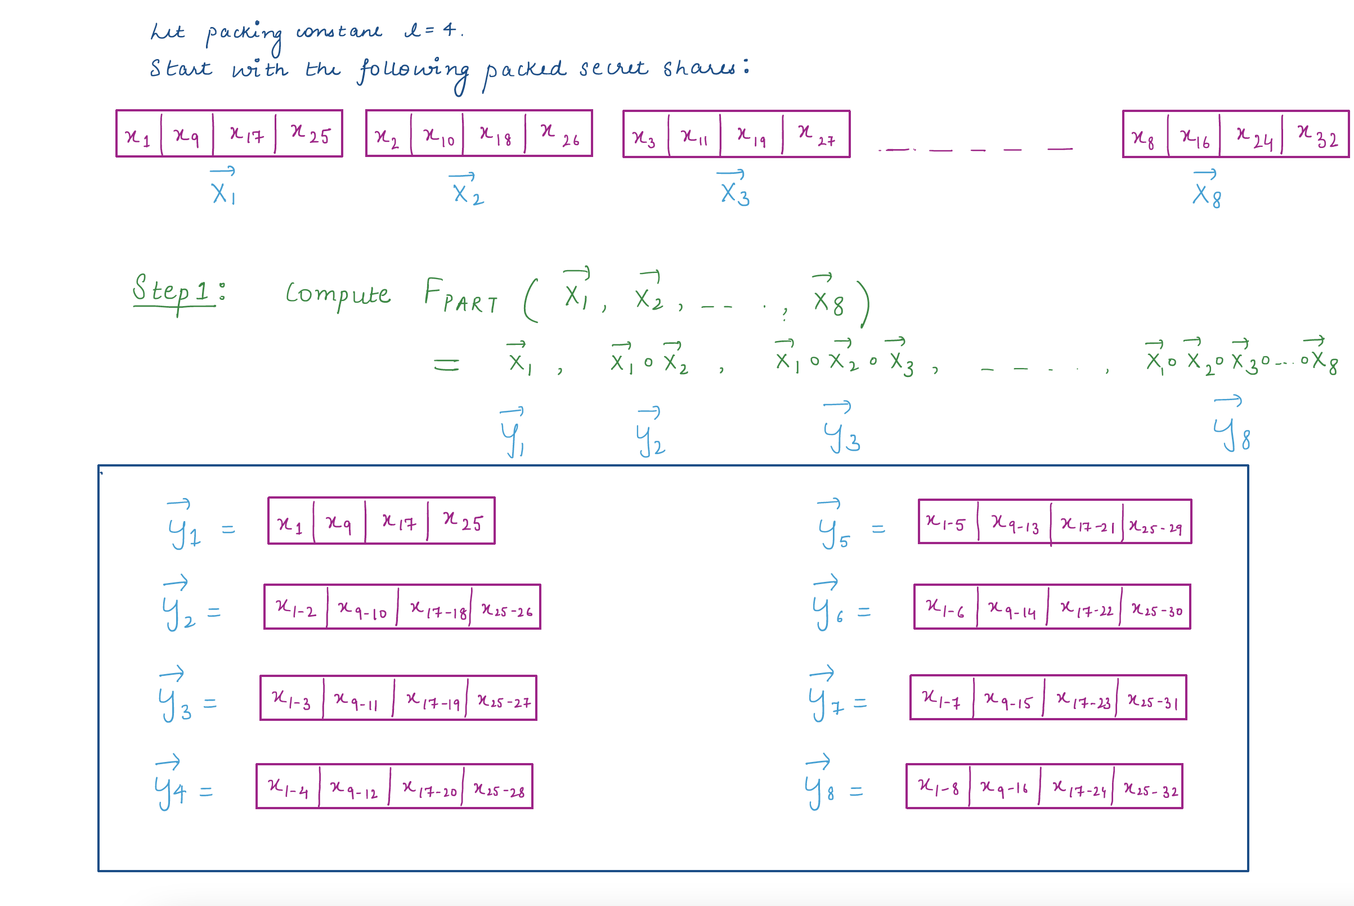
Distributed Protocol for Partial Products
Notes:
\

Slide 33
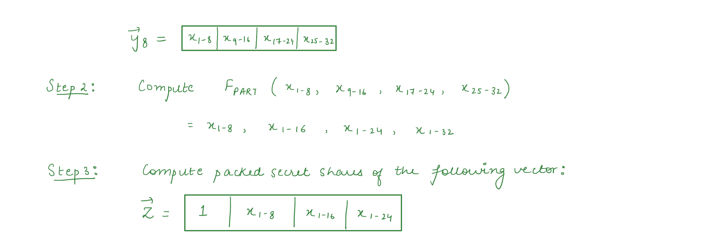
Distributed Protocol for Partial Products

Slide 34
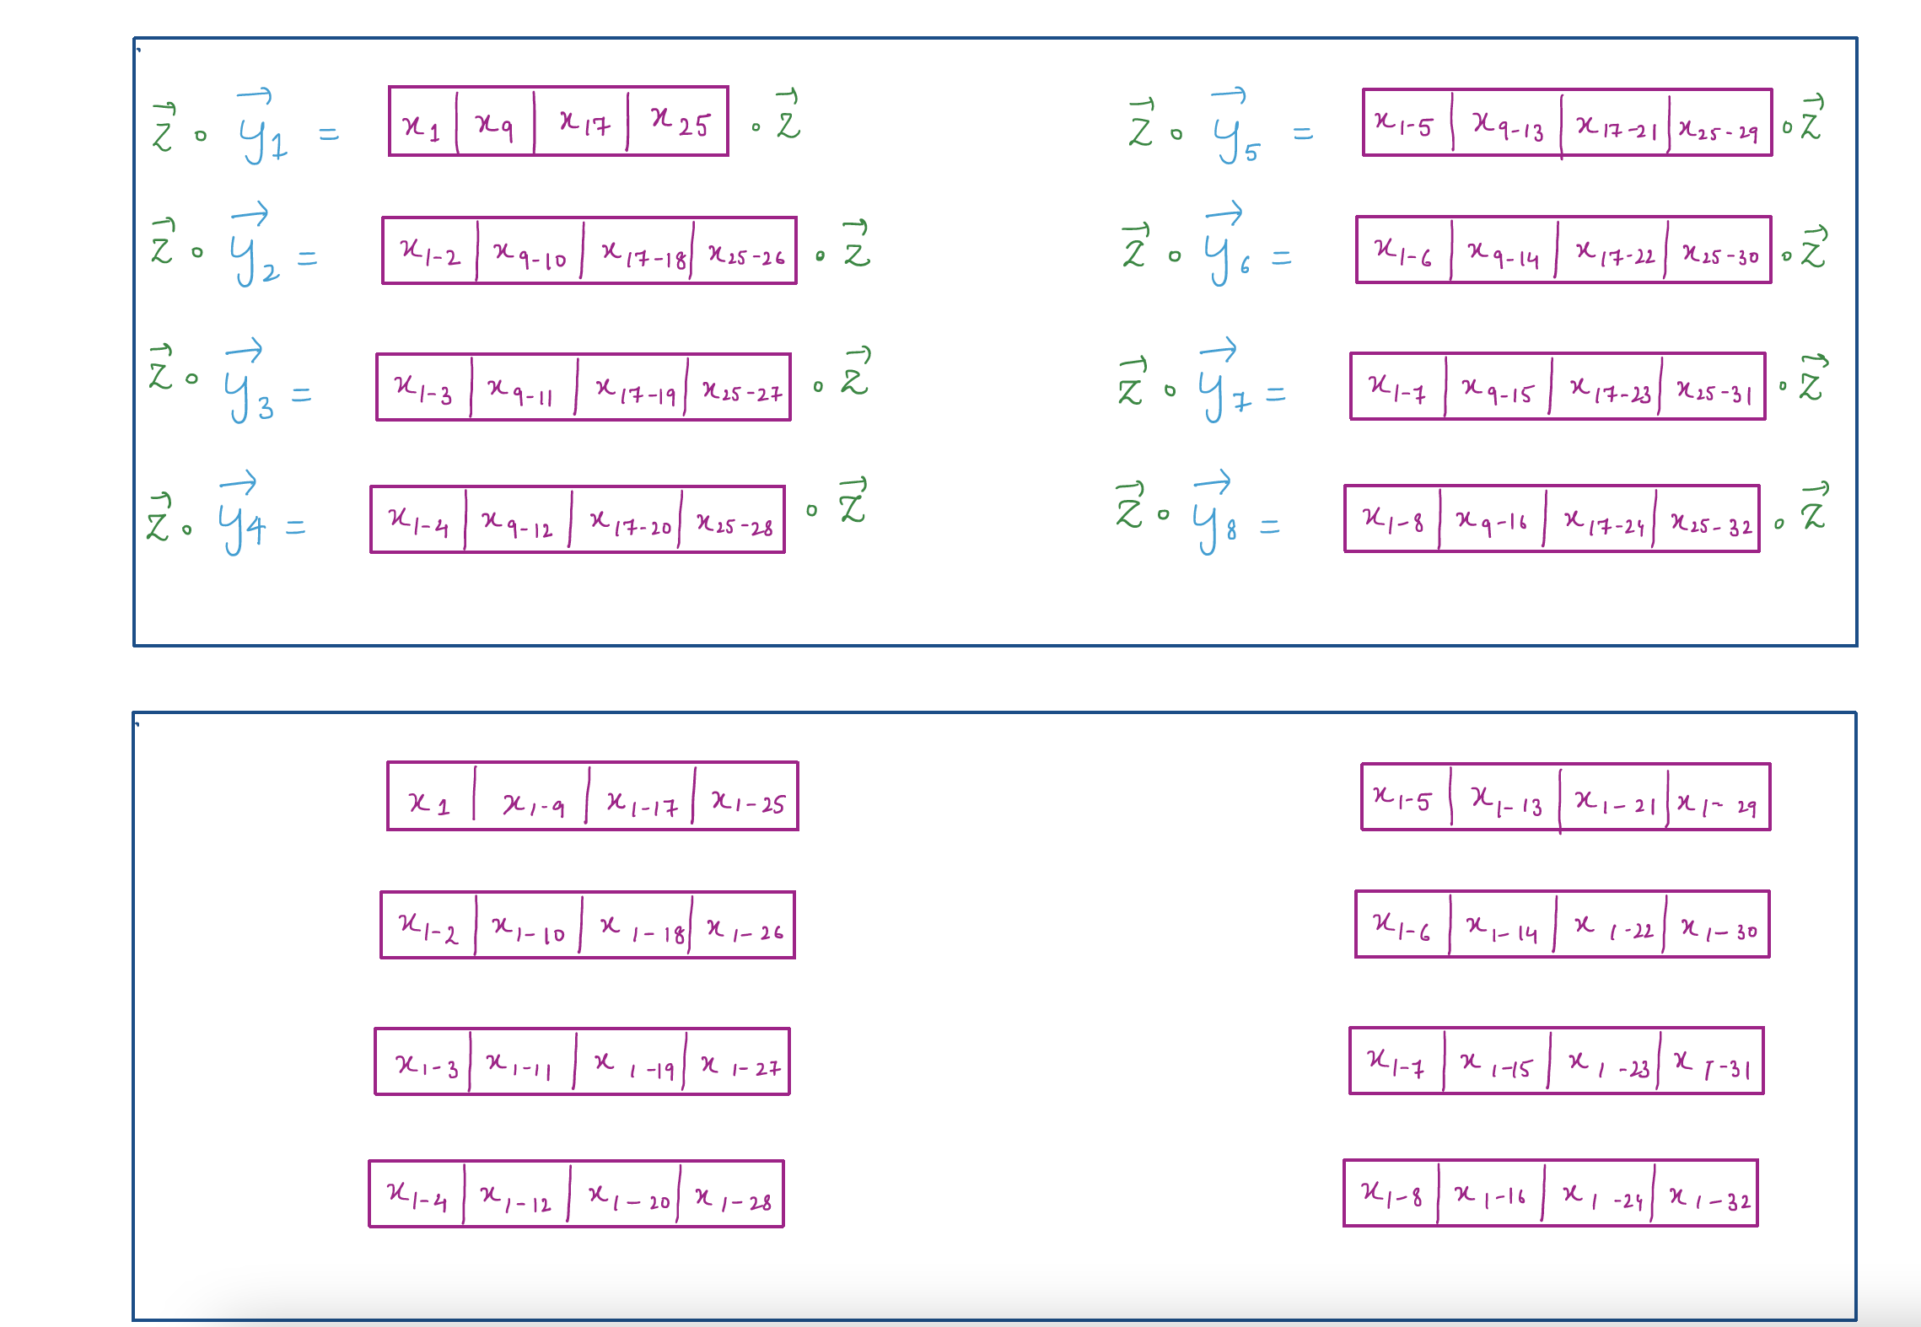
Distributed Protocol for Partial Products

Slide 35
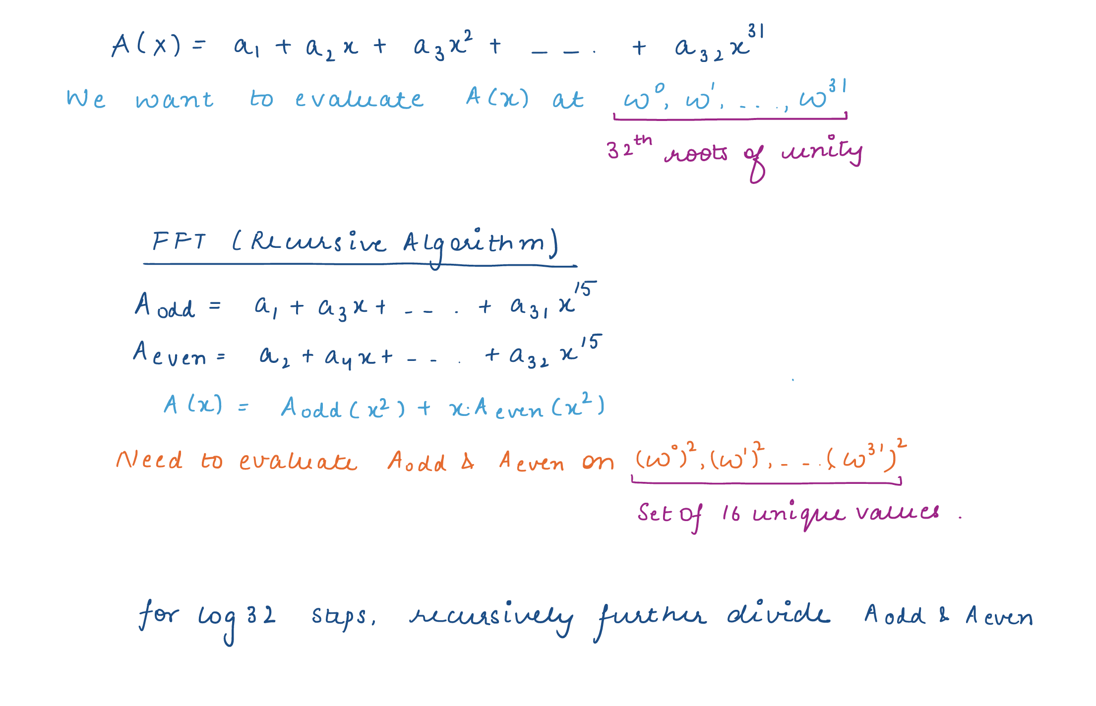
Distributed Protocol for Fast Fourier Transform

Slide 36
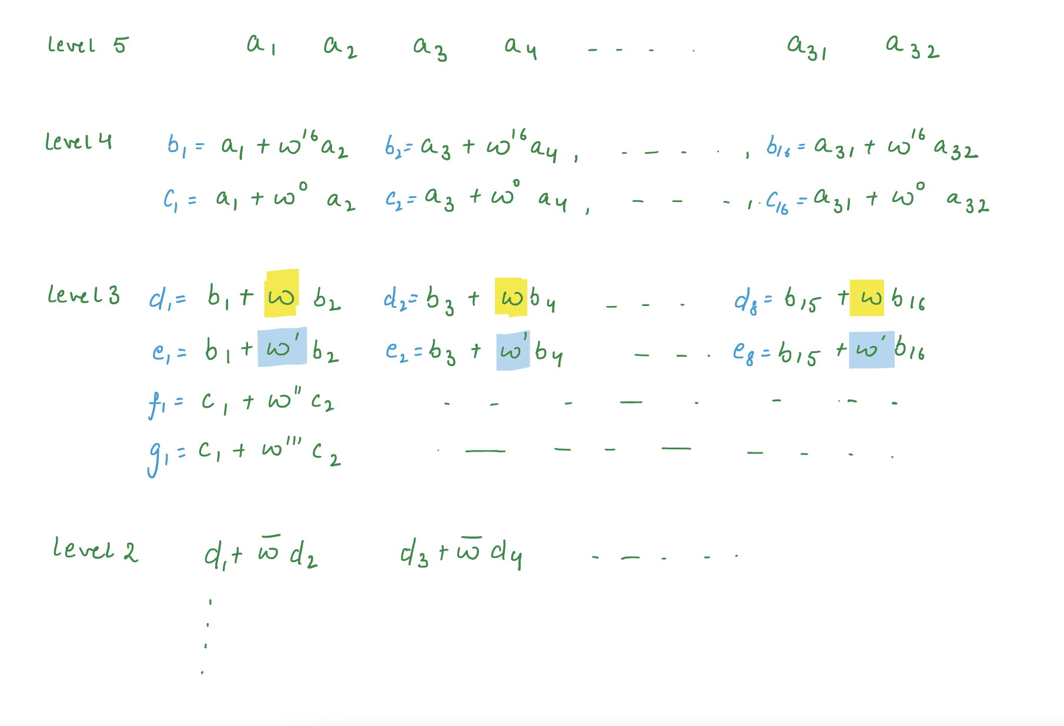
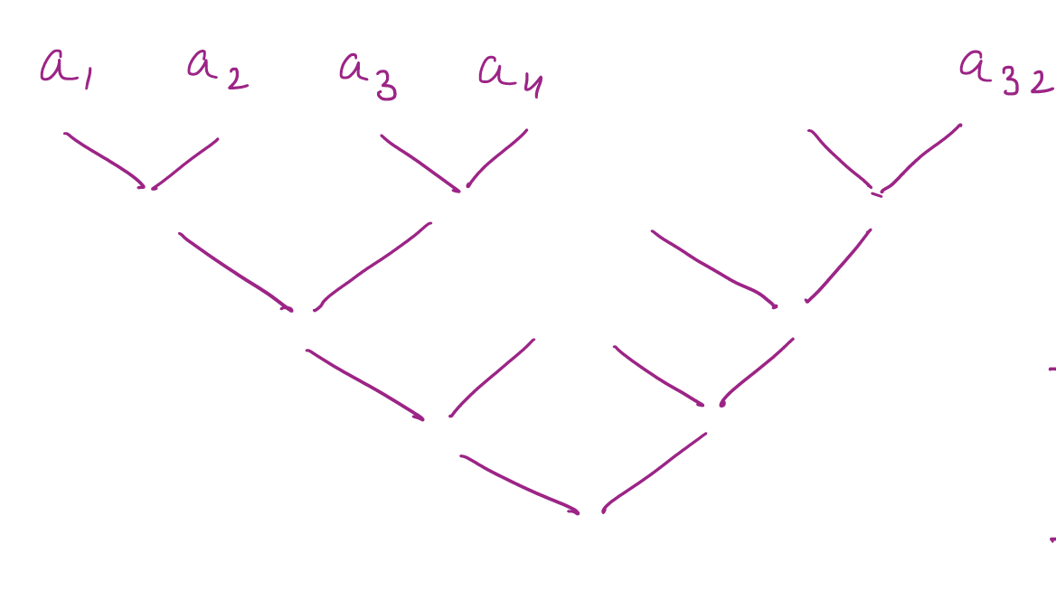
Distributed Protocol for Fast Fourier Transform

Slide 37
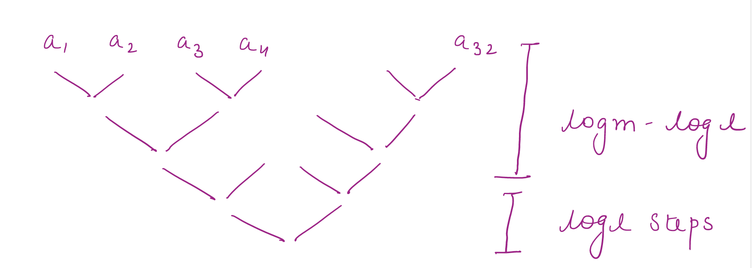
Distributed Protocol for Fast Fourier Transform

Slide 38
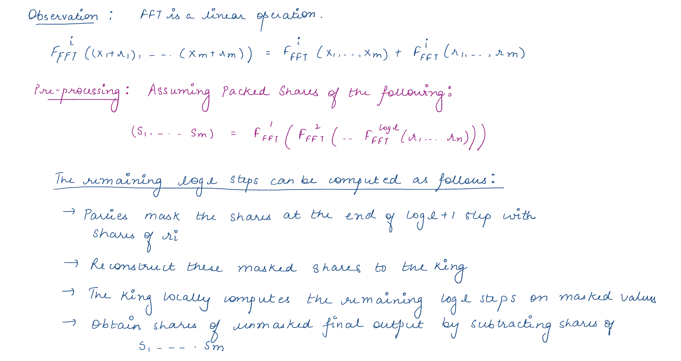
Distributed Protocol for Fast Fourier Transform

Slide 39
Distributed Protocol for Multi-Scalar Multiplications
$$F\left(g_{1},α_{1},…,{g_{m},α}_{m}\right)=\prod_{i∈[m]}{{g_{i}}^{α_{i}}}$$

Slide 40
Distributed Protocol for Multi-Scalar Multiplications
$$F\left(g_{1},α_{1},…,{g_{m},α}_{m}\right)=\prod_{i∈[m]}{{g_{i}}^{α_{i}}}$$

Slide 41
Distributed Protocol for Multi-Scalar Multiplications

Slide 42
Experimental Results

Slide 43
zkSaaS for Groth16: Setup
N1 GCP Instances
Local Prover
zkSaaS Servers
1vCPU and 4 GB RAM
96vCPU and 128 GB RAM
1vCPU and 2 GB RAM each

Slide 44
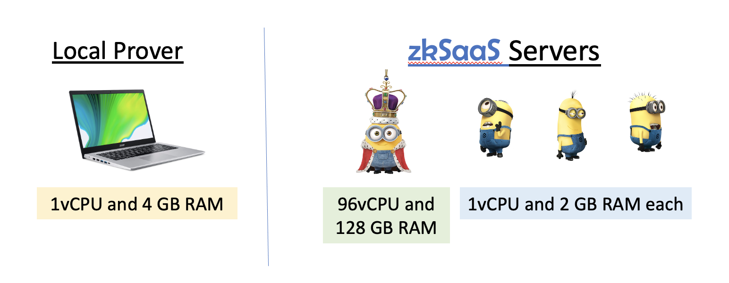
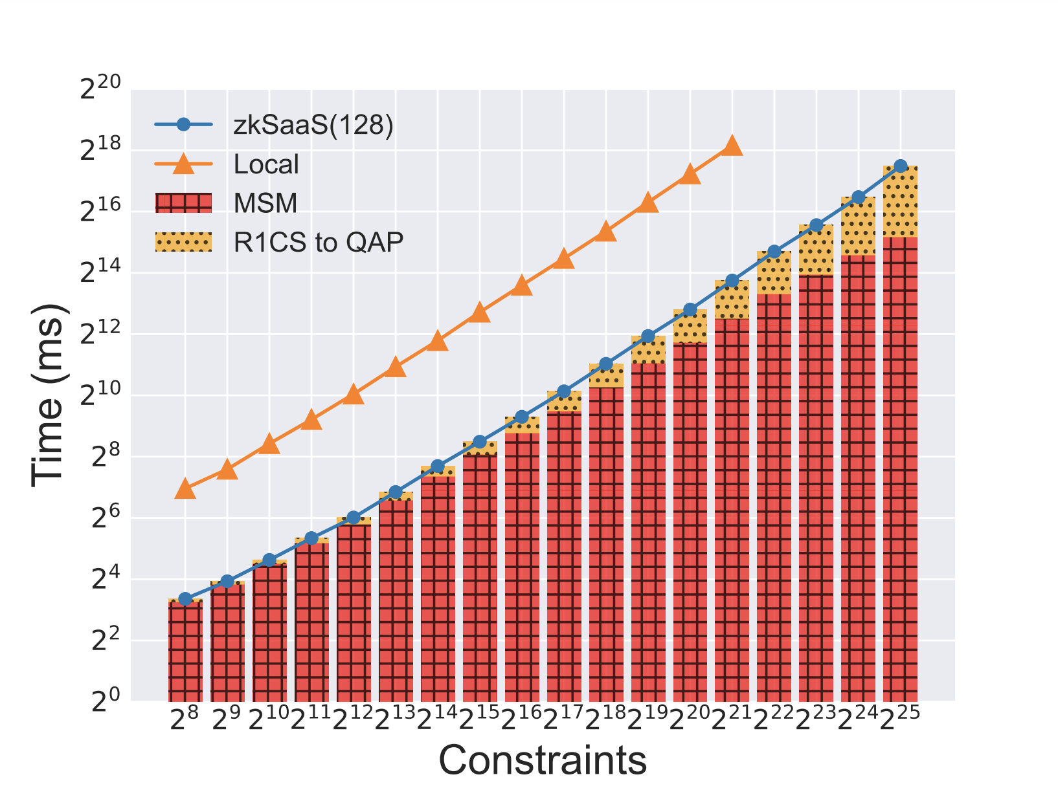
zkSaaS for Groth16: Evaluation
No. of Servers = 128
Packing constant = 32
No. of corrupt servers =32
Memory Exhaustion
Weak servers can handle 16 times more constraints than consumer machine before running out of memory
Varying No. of Constraints

Slide 45
zkSaaS for Groth16: Evaluation
No. of Servers = 128
Packing constant = 32
No. of corrupt servers =32
Running Time
We get 22 times speedup over consumer machine
Why not 32 times?
FFT doesn’t achieve equal division of work
Sub-optimal use of Pippenger’s algorithm for MSMs
Varying No. of Constraints

Slide 46
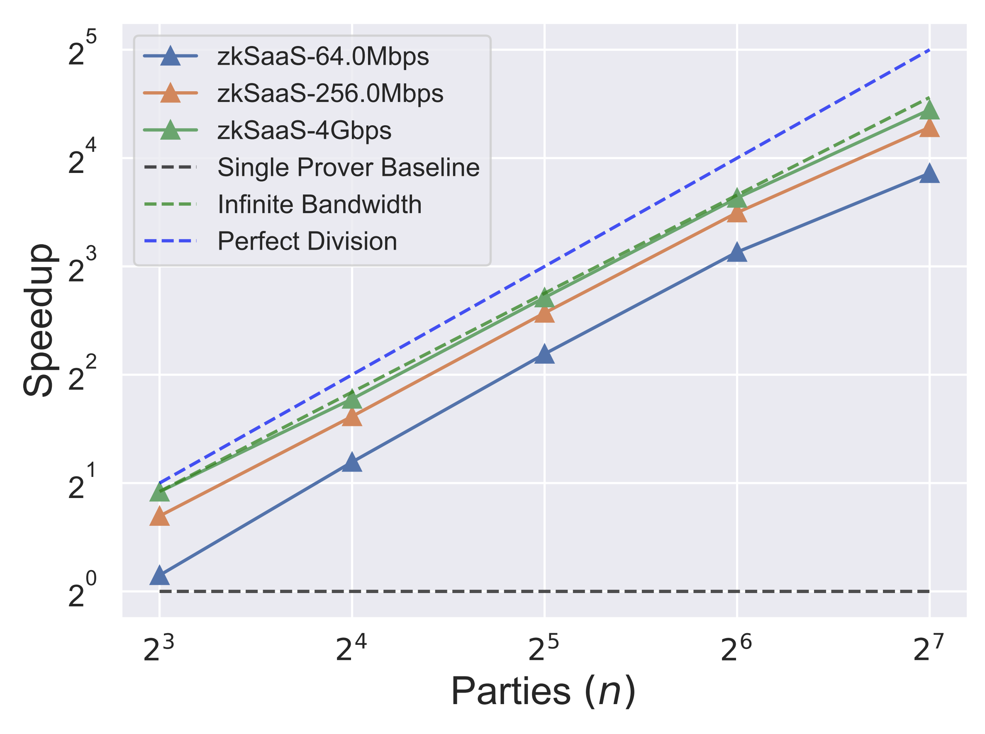
zkSaaS for Groth16: Evaluation
No. of Constraints = 2¹⁹
Packing constant = n/4
No. of corrupt servers = n/4
Varying No. of Parties

Slide 47
Thanks!

